Slide 1
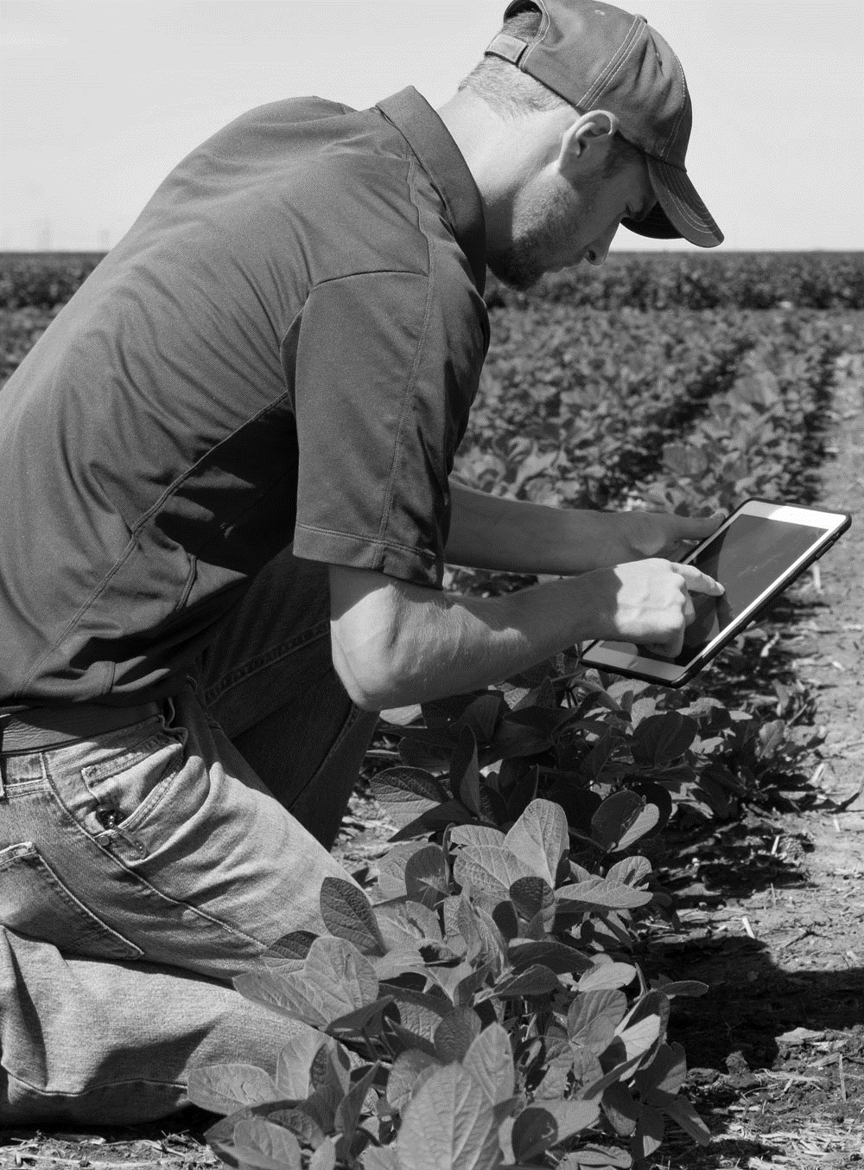

Behavioral Economics in Agriculture
Ray Massey
Professor, Agricultural Economics

Slide 2
Presentation Objectives
Present ideas and book suggestions on how people are influenced when they make decisions.
Show how these concepts are used in agriculture.
Illustrate how to use this type of information.

Slide 3
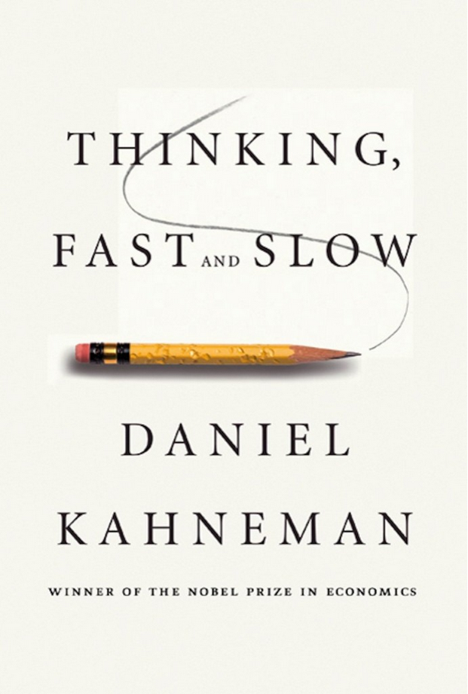

Slide 4

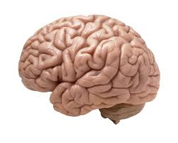
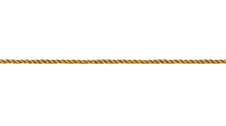
System I
Automatic System
System II
Rational System
Behavioral Econ
Rapid, intuitive decisions
Decisions are made under incomplete information
Choices are often based on unconscious processes and influences
Necessary to get anything done
Traditional Econ
Slow, methodical decisions
People are more fully informed
Choices are purely conscious
Necessary for unfamiliar or complex decisions
Notes:
Human decision making deviates substantially from a normatively rational, deliberate and conscious process (Kahneman and Tversky 1979)
An alternative view emerged from the work of Kahneman and Tversky in the late 1970s.
In general there are 3 notable effects that argue for a need for assessing unconscious effects in consumer choice
Framing effects and other contextual cues affect our choices without our knowledge of being affected.
We do not decide after carefully and rationally calculations the effects of each option
Rather our choices happen almost instantly and mostly after just receiving a fraction of all available information about our choice options.
This all means that we r not rational, not fully informed, we are influenced by others, and our choices are not purely concious.
So can we trust what people respond when we ask them why they choice as they did? This is a major problem and as we can see for a full understanding of consumers we need models and methods that focus on both conscious and unconcious choices.

Slide 5
Thinking fast or slow?
A bat and ball cost $1.10 in total. The bat costs $1.00 more than the ball. How much does the ball cost? _____ cents
1 cent
5 cents
10 cents

Slide 6
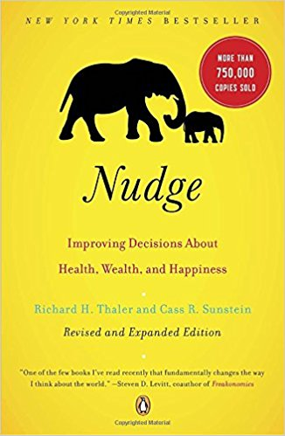
“If you want to get people to do something, make it easy! Remove the barriers.” Richard Thaler

Slide 7
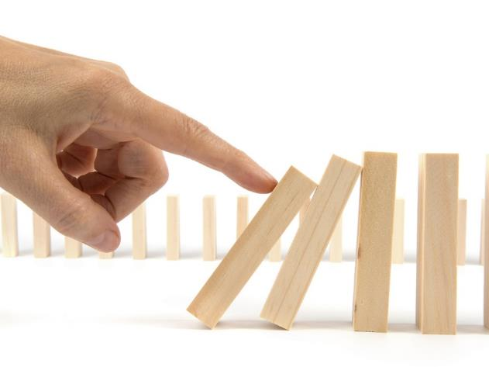
What is a Nudge?
Effort to
achieve non-forced compliance
influence the motives, incentives and decision making of groups and individuals by
  Positive Reinforcement
  Indirect Suggestions
  Defaults Choices

Slide 8
Characteristics of a Good Nudge
Timely
Social
Easy
Attrac-tive

Slide 9
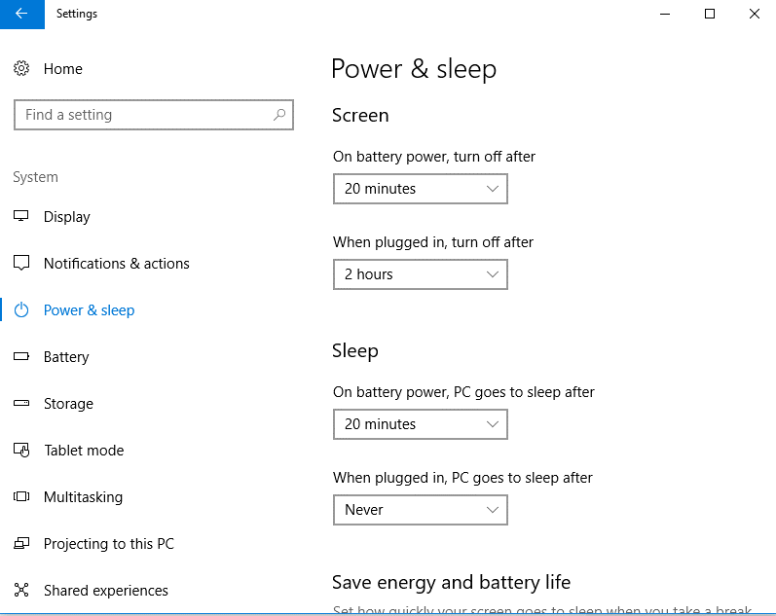
Choice Architecture:
Default Settings

Slide 10
Defaults in Agriculture
Commodity Checkoff Programs
  Paying is automatic when selling
  A refund must be requested
Subscriptions
  Initial signup
  Subsequent renewals are automatic.
Takes advantage of the power of inertia, or Status Quo Bias.

Slide 11
Status Quo Bias
First month free. Monthly subscription of $15 after that. You can cancel at any time.
I have never accepted such an offer.
I have accepted such an offer and cancelled after the first month.
I have accepted such an offer and did not cancel as soon as planned.

Slide 12
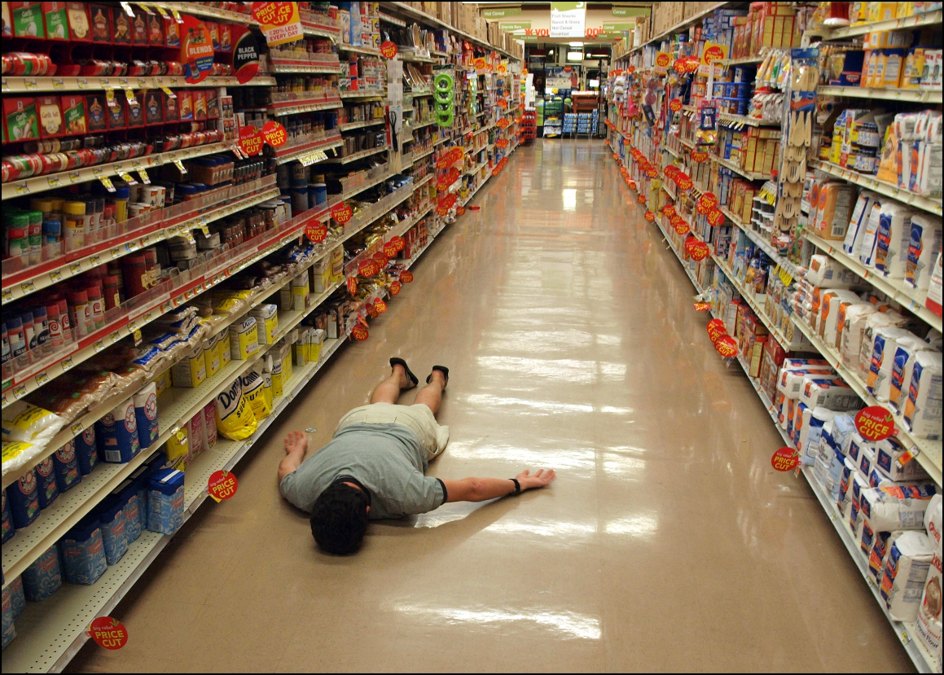

Is more always better?
Notes:
We find it hard to make a choice when more options are available
Consider the problem of a consumer in a modern supermarket. The typical store sells more than 40k items, and in many product categories it offers hundreds of options. The typical consumer is also time constrained and cannot afford to spend too much time making each selection. To solve this decision problem consumers need to perform a dynamic search over the set of feasible items under conditions of extreme time pressure and choice overload.
What scientists have been saying for decades is that choice is motivating, that having choice or even the illusion of choice is ass. With increased satisfaction and having more control over your life. This ideas about choice were not prominent just in psychology they were baked into the foundation of economic theory at the time: that more choice is almost always better than less choice.

Slide 13
Choice overload in agriculture
Page 1 of 34
Notes:
The application process should be as simple as possible to maximize participation. Thinking critically about the information that is truly needed from participants is one way to simplify a program.

Slide 14
CRP Signup proposal
Current enrollment process - farmers compete on the basis of their Environmental Benefit Index (EBI), which reflects the conservation practices they have agreed to implement.
  The default starting point for the EBI is no conservation practices.
  Farmers improve their EBI by agreeing to implement better, generally more expensive, practices.
Possible change – set the default starting point to the best practices and then allow farmers to opt out of those practices.

Slide 15
Characteristics of a Good Nudge
Timely
Social
Easy
Attrac-tive

Slide 16
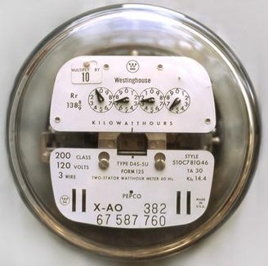
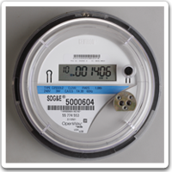
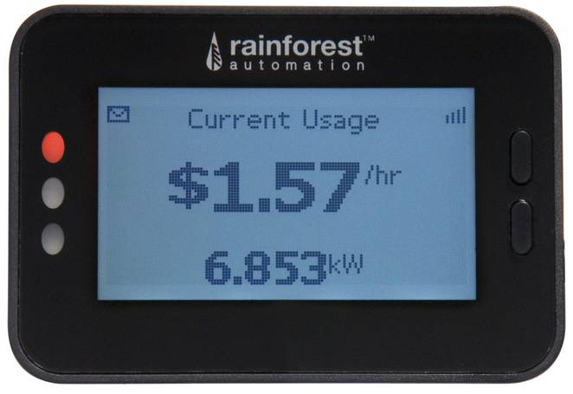
Meet the Users’ Objectives

Slide 17
Characteristics of a Good Nudge
Timely
Social
Easy
Attrac-tive

Slide 18
Optimism and Overconfidence
I think my driving skills are________.
  Below average
  Average
  Above average

Slide 19
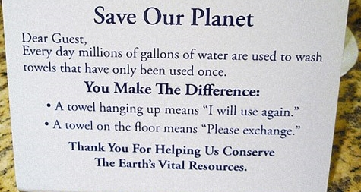
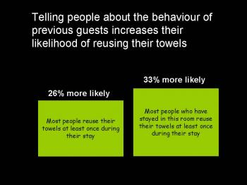
Notes:
https://www.psychologytoday.com/blog/yes/200808/changing-minds-and-changing-towels

Slide 20

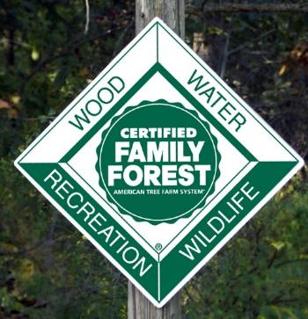
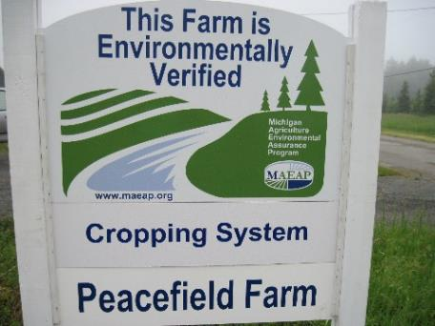



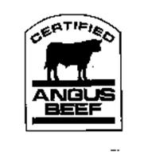
Peer pressure/pleasure

Slide 21
Social Norms in Agriculture
In counties where contract holders are substantially delayed in meeting their contractual obligations, notifying contract holders about the high percentage of producers in their state who are in compliance with their contracts could reduce the “late rate.”
use comparison groups that the targeted participants care about, such as their neighbors in the county or other state residents, and to
make clear that the desired behavior is common among members of those groups

Slide 22
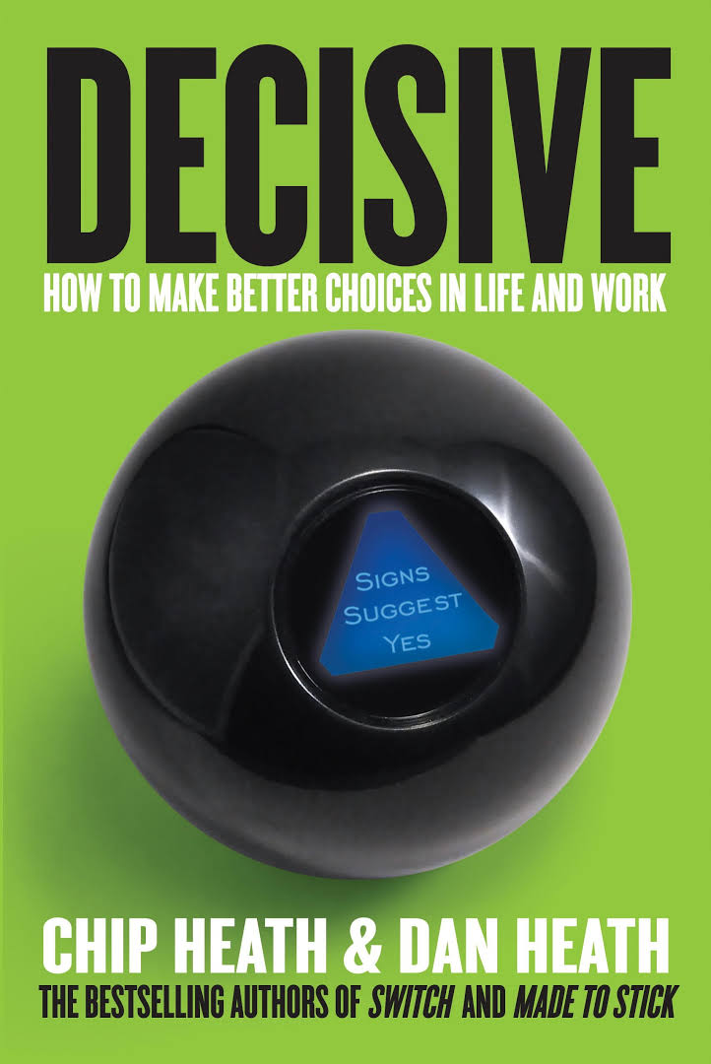
Good book on Business Decision Making

Slide 23
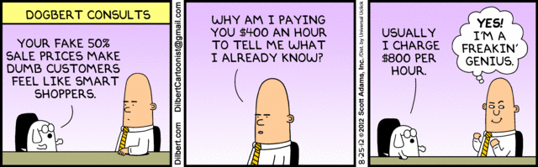
Reference Points

Slide 24
Reference Points

Slide 25
Reference Points

Slide 26
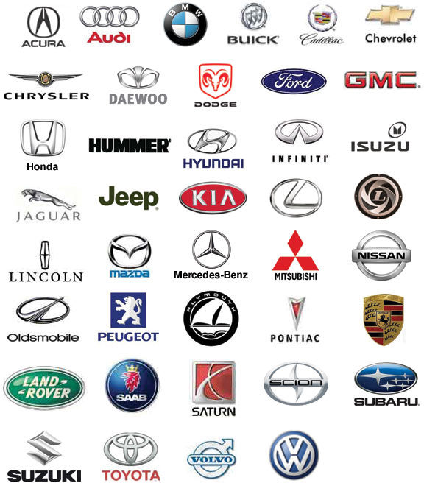
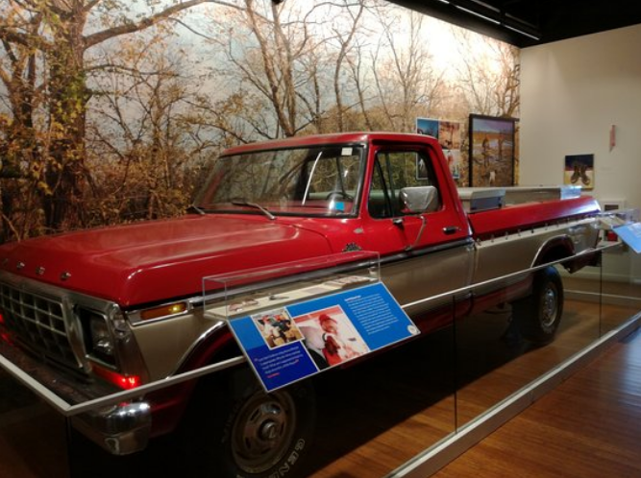
  Reference Points

Slide 27
Which would you choose?
Get $900 for sure
90% chance to get $1000;
10% chance to get $0

Slide 28
Which would you choose?
Lose $900 for sure
90% chance to lose $1000;
10% chance to get $0.

Slide 29
Choice Insights
Problem 1. Get $900 for sure OR 90% chance to get $1000.
  Either choice has the same expected value.
  Most chose $900 for sure because they are risk averse when gains are possible.
Problem 2. Lose $900 for sure OR 90% chance to lose $1000.
  Either choice has the same expected value.
  Most choose the gamble because they are loss averse when losses are possible.

Slide 30
You are offered a gamble on the toss of a coin.
Heads: you lose $100
Tails: you win $150
Accept the offer.
Reject the offer.

Slide 31
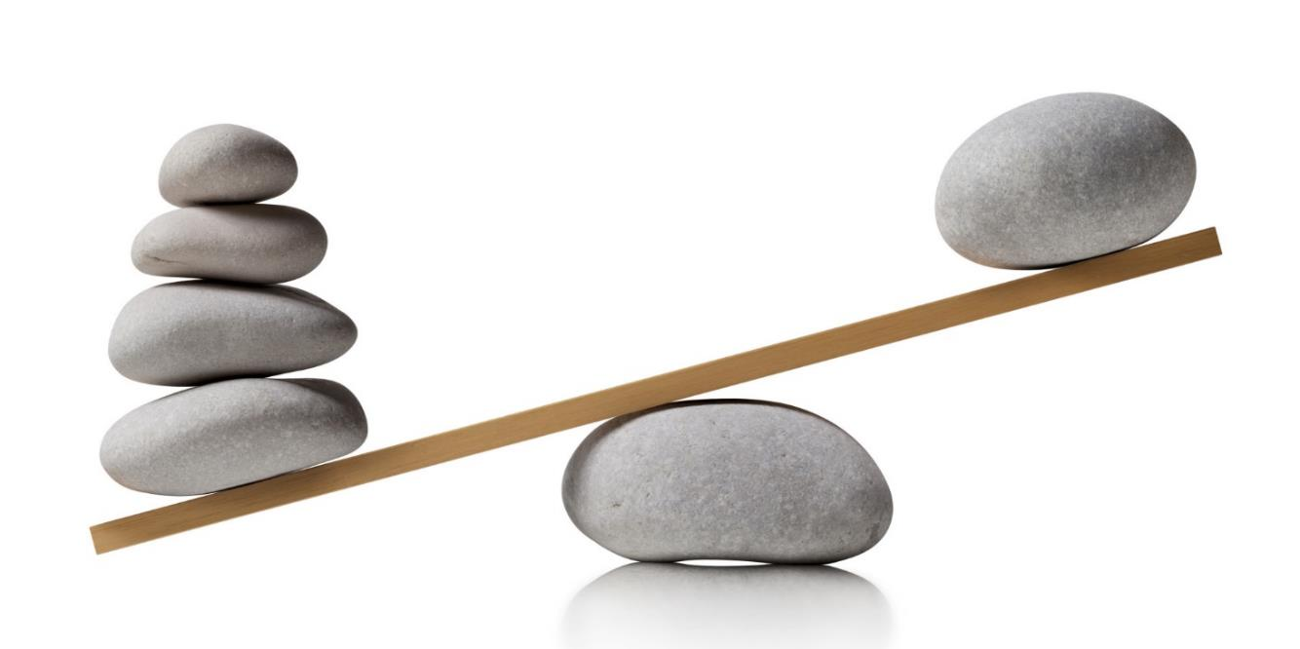
People hate to lose things! “Loss Aversion”
Loss
Gain
Notes:
An important factor in economic decisions is loss aversion. Loss-averse individuals attach greater significance to losses than to gains (Tversky and Kahneman, 1991).
Loss aversion: The first concept I always bring up is loss aversion for two reasons: 1. it is a very simple concept to grasp and understand, the examples are everywhere. 2. its one of the truest foundations of behavioral econ itself with that faithful study by Khaneman and Tversky in 1979 I mentioned at the beginning. This study was link to loss aversion and prospect theory.
It would not surprise you to know that people hate to lose things.
Losses loom larger than gains
Gains are not the key to driving behavior, loses are.
The motivation of a loss is as twice as powerful as the motivation of a gain. So if you lose $20 it would theoretically take finding $40 to make up for the pain felt from that loss. This is known as prospect theory, and the article by Khaneman and Tversky that really change the face of economics has the same name. In his book, Kahneman shows how changing wording in a way that shouldn’t make a difference actually does.
The gain–loss disparity refers to the situation where people are signiﬁcantly more averse to losses than they are attracted to gains of the same magnitude. To most people, losses appear to matter much more than gains

Slide 32
Endowment Effect
The Endowment Effect is an application of “loss aversion.”
People will tend to pay more to retain something they own than to obtain something they do not own.

Slide 33
Possible Endowment Effects in Agriculture
Landowners are reluctant to reduce rents because they view the current rent as an endowment.
Farmers retain assets (especially land) longer than they should from a purely business perspective.
Family living is particularly difficult to decrease because other members of the family see it as an expectation (an endowment).

Slide 34
Renegotiating a Contract
The existing contract terms are the “reference points.”
Proposed changes are viewed as a concession that one side makes to the other.
Concessions you make to me are your losses; your losses cause you more pain than any increased values I get cause me pleasure.
When you demand a concession from me, they are my losses. You don’t appear to value my losses sufficiently (because your gain gives you less pleasure than the same loss causes me pain.)
Loss aversion creates an asymmetry that makes agreements difficult to reach.
Negotiations over a shrinking pie are difficult because they require an allocation of losses; an expanding pie is an allocation of gains.

Slide 35
Reference Point
Rental rates are falling but current landowners don’t think it is fair that their current rent falls as well.
  Their reference point is their existing rental payment rather than the going rental payment.
  Rental rates are falling but landowners costs have not decreased so they don’t think it fair that their rental charges go down. Their reference point is their existing rental charge.

Slide 36
Renegotiation
(Decision Framing)
Attempt to communicate your reference point and provide an anchor to the other side.
Introduce other reference points (contract terms) for which the current reference point is
  A gain to the other party – e.g. timing of payments
  Already low – add an activity such as road repair or fence management.
Suggest a change that gives some hope of not losing – variable rate lease.

Slide 37
