Slide 1

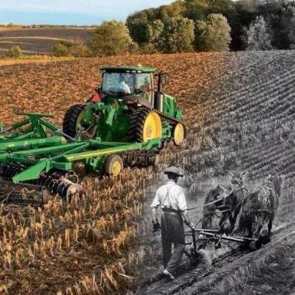
Leading the Discussion About Agriculture…
The Talk
vs.
The Truth
Ag Inspirations LLC. ©2019. All rights reserved.

Slide 2
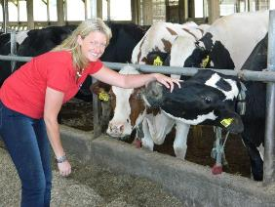

Slide 3

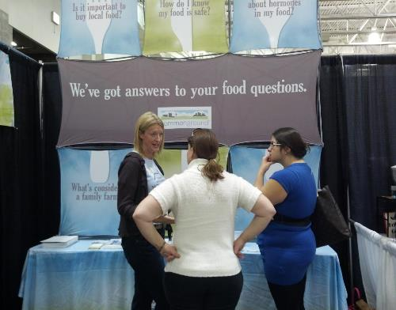

Slide 4


Slide 5
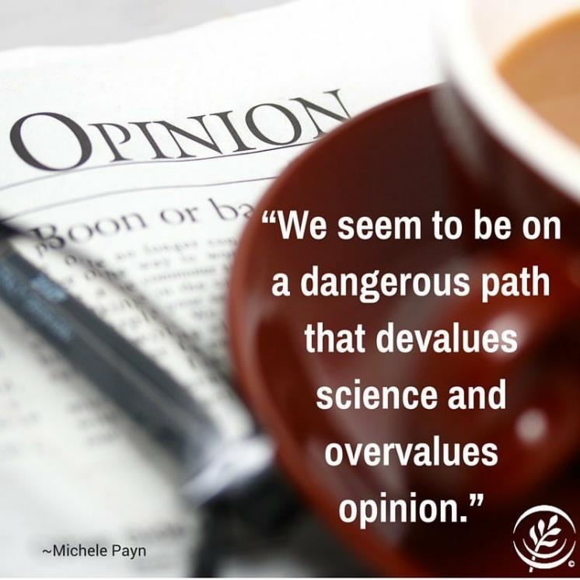

Slide 6
The Talk vs. The Truth
“Don’t eat something you
can’t pronounce!”
“Chemicals are bad!”

Slide 7
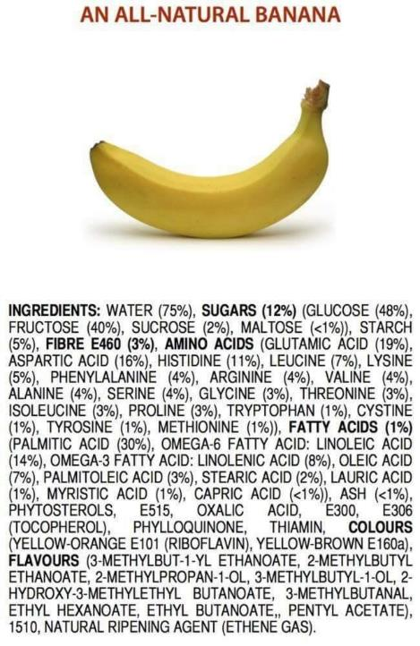
The Talk vs. The Truth
“Don’t eat something you
can’t pronounce!”
“Chemicals are bad!”

Slide 8
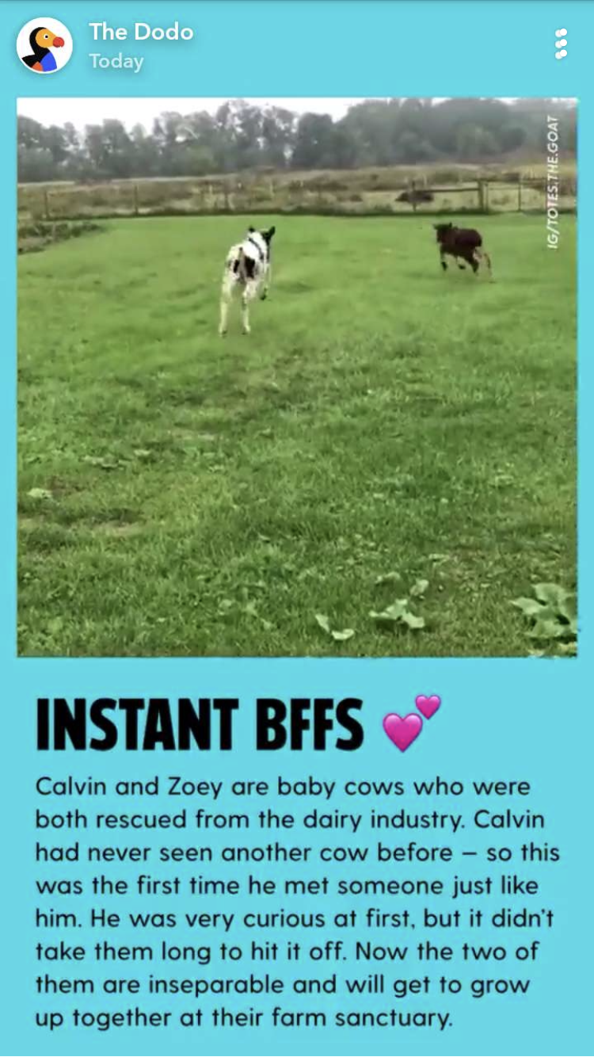
The Talk vs. The Truth
“…rescued from the dairy industry…”

Slide 9



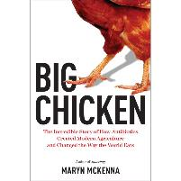


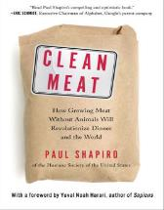


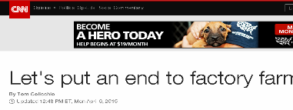



The Story of Agriculture Consumers See

Slide 10
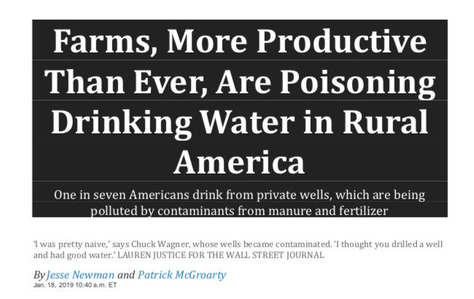
The Talk vs. The Truth

Slide 11
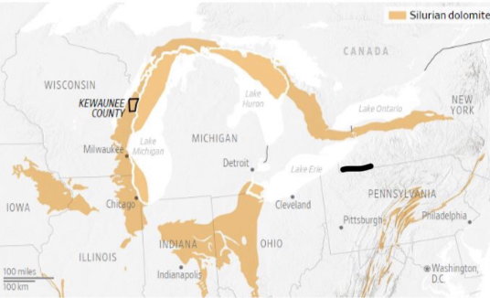
The Talk vs. The Truth

Slide 12
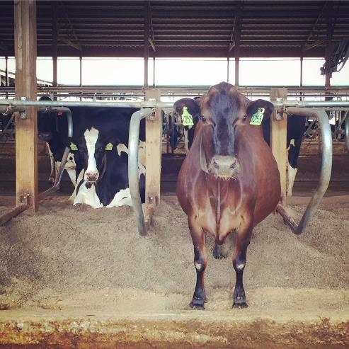
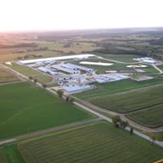
The Talk vs. The Truth
By the Numbers…
5X cows to people in Kewaunee County
Total cow manure = 210X human sewage
(700 million gallons from cattle)

Slide 13
The Talk vs. The Truth
The Research…
138 samples from 131 wells (4,896 private wells)
44 bovine fecal source
33 human fecal source
9 contained both
Source:Mark Borchardt, Ph.D., USDA-ARS, USGS Upper Midwest Water Science Center 2019

Slide 14
The Talk vs. The Truth
~50% of the well contamination came from bovines…

Slide 15
The Talk vs. The Truth
~50% of the well contamination came from bovines…
who have 210X the amount of fecal waste

Slide 16
The Talk vs. The Truth
Maybe
AGRICULTURE
holds more answers for the solutions?!

Slide 17
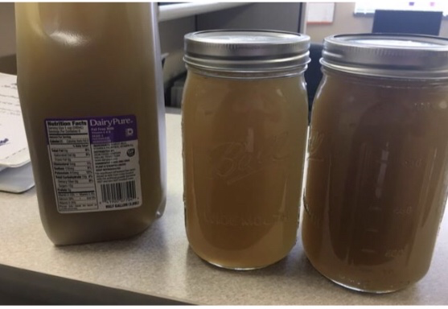
The Talk vs.
The Truth
Not Newsworthy
Wausau, WI: 3.7 million gallons of human sewage poured into the WI River in one 2018
“controlled release.”

Slide 18
The Talk vs.
The Truth
Not Newsworthy
Wausau, WI: 3.7 million gallons of human sewage poured into the WI River in one 2018
“controlled release.”
740 manure tankers!

Slide 19
The Talk vs. The Truth
“A reliable way to make people believe in falsehoods is
frequent repetition because familiarity is not easily
distinguished from the truth.” – Daniel Kahneman

Slide 20
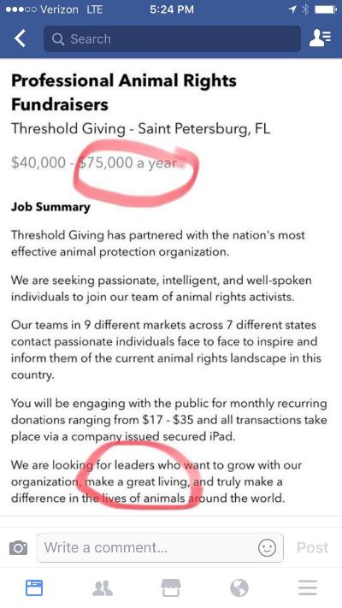
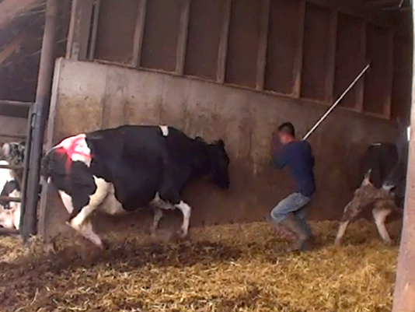
The Story of Agriculture Consumers See

Slide 21


The Story of Agriculture Consumers See

Slide 22
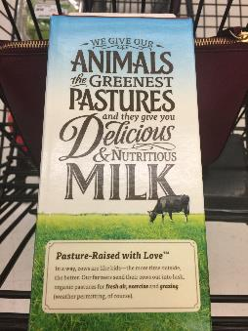
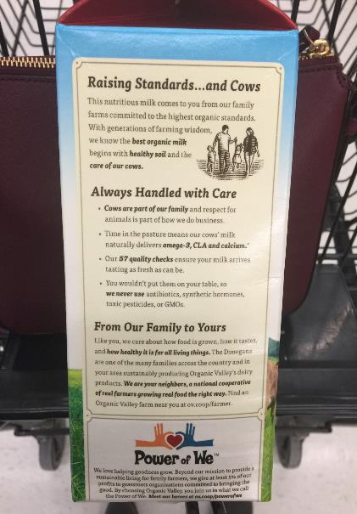
The Story of Agriculture Consumers See

Slide 23
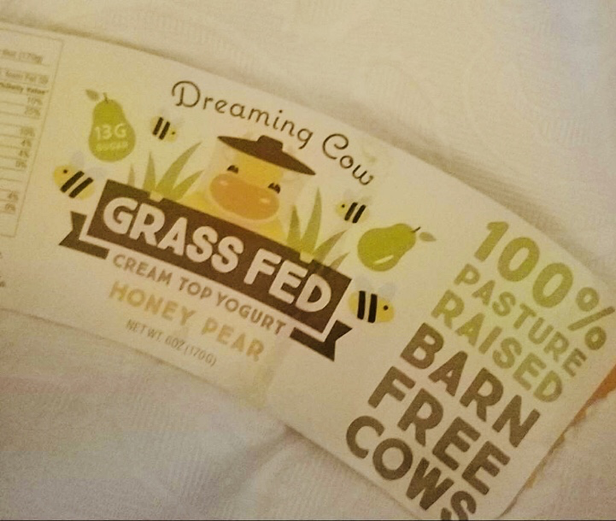
The Story of Agriculture Consumers See

Slide 24


Our Competition is Tough
Hollywood/Entertainment
Media
School
Friends
Politics
Where is the farmer & rancher voice in these conversations?
Work
Restaurants
Wellness Professionals
Social Media
Online/
Search

Slide 25
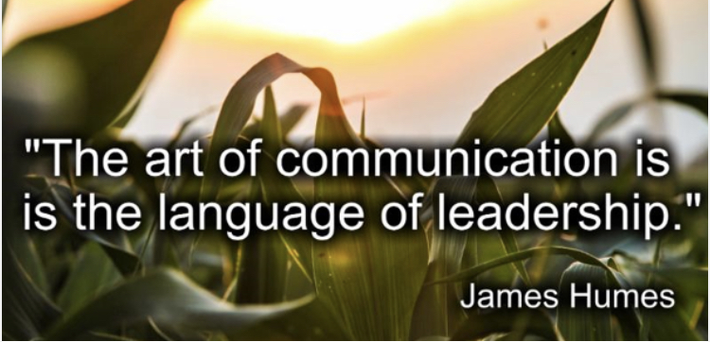
We Need to Do BETTER!

Slide 26
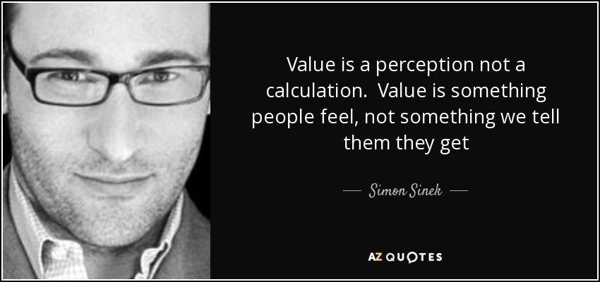

Slide 27

Communicate with E.A.S.E.
Source: USFRA Conversations with E.A.S.E. Training

Slide 28
Communicate with E.A.S.E.
Engage
Look for a connection and start a conversation…
- questions
- compliments
- introductions
Source: USFRA Conversations with E.A.S.E. Training

Slide 29

Communicate with E.A.S.E.
Engage
Acknowledge
- Acknowledge ALL questions and concerns, even if they are not the same as your own!
Source: USFRA Conversations with E.A.S.E. Training

Slide 30
Communicate with E.A.S.E.
Engage
Acknowledge
- Acknowledge ALL questions and concerns, even if they are not the same as your own!
“I can understand why you’re concerned about that. There is a lot of misinformation out there. On farms, we do this…”
“That’s a great questions! I have actually seen…”
Source: USFRA Conversations with E.A.S.E. Training

Slide 31
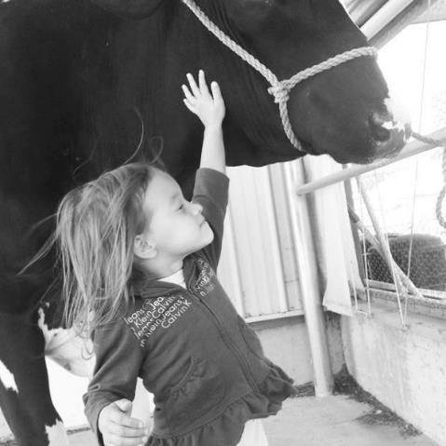
Communicate with E.A.S.E.
Engage
Acknowledge
Share
Talk about what you do
and why.
Source: USFRA Conversations with E.A.S.E. Training

Slide 32
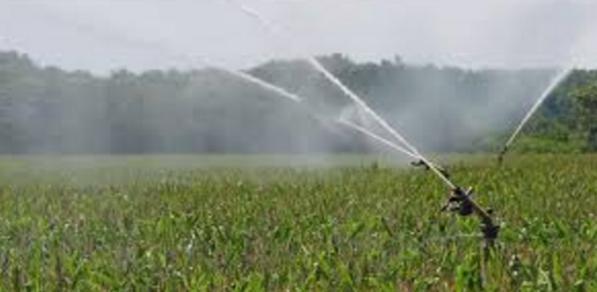



Primary Consumer Concerns
Water
Air
Soil
Habitat
Source: USFRA Conversations with E.A.S.E. Training

Slide 33
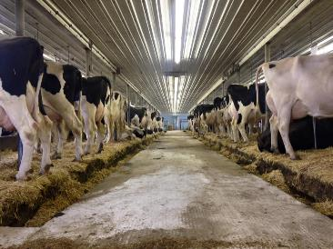
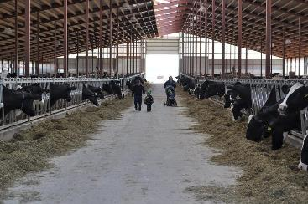
The Words You Choose
Think like a consumer…
WORDS are the tools that
shape perceptions!

Slide 34
The Words You Choose
Pesticides: What we use to prevent bugs from eating and stealing nutrients from our crops.
Think like a consumer…
WORDS are the tools that
shape perceptions!

Slide 35
The Words You Choose
Pesticides: What we use to prevent bugs from eating and stealing nutrients from our crops.
Fertilizers and Nitrogen: We nurture plants with nutrients at exactly the right time in the right amount to help our crops grow & thrive.
Think like a consumer…
WORDS are the tools that
shape perceptions!

Slide 36
The Words You Choose
Pesticides: What we use to prevent bugs from eating and stealing nutrients from our crops.
Fertilizers and Nitrogen: We nurture plants with nutrients at exactly the right time in the right amount to help our crops grow & thrive.
Hutches Nursery
TMR Balanced Cow Casserole
Activity Monitors Fit Bits for Cows
Productivity Improving
GMO’s Precise Plant Breeding
Think like a consumer…
WORDS are the tools that
shape perceptions!

Slide 37


Communicate with E.A.S.E.
Engage
Acknowledge
Share
Earn Trust
Source: USFRA Conversations with E.A.S.E. Training

Slide 38
Communicate with E.A.S.E.
Engage
Acknowledge
Share
Earn Trust
People don’t buy what you do,
they buy WHY you do it…
Source: USFRA Conversations with E.A.S.E. Training

Slide 39

The Message That Matters
How we are always improving the care for the land…
How we are always improving the care for your animals…
How we are always improving to conserve resources…

Slide 40

Our Story of Sustainability

Slide 41
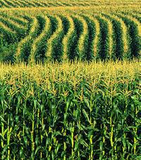
Our Story of Sustainability

Slide 42
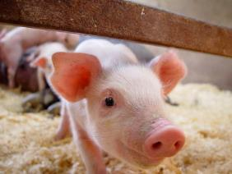
Our Story of Sustainability

Slide 43
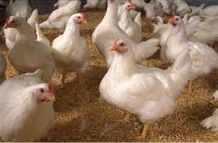
Our Story of Sustainability

Slide 44
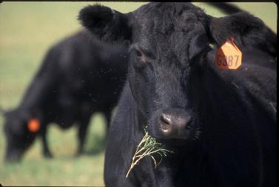
Our Story of Sustainability

Slide 45
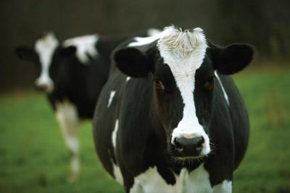
Our Story of Sustainability

Slide 46
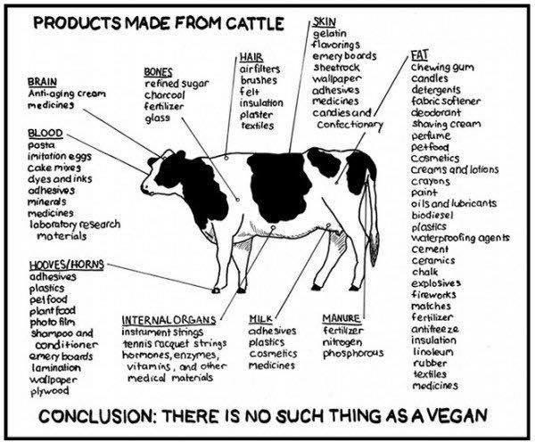
Our Story of Sustainability

Slide 47
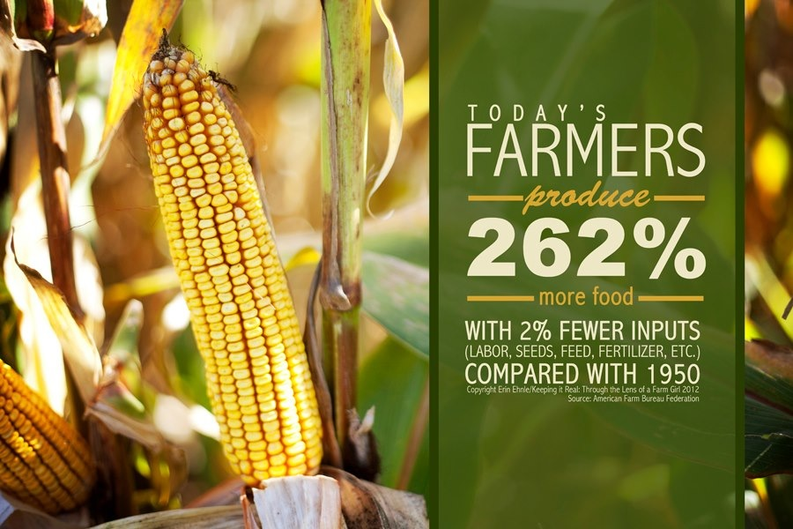

Slide 48
How Did We Do This?

Slide 49

Sustainable Practices
Continual Improvements in Genetics
Continual Improvements in
Animal Welfare
Continual Improvements in
Cropping Practices

Slide 50
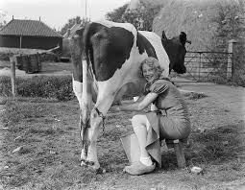
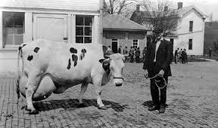
Continual Improvements in Genetics

Slide 51
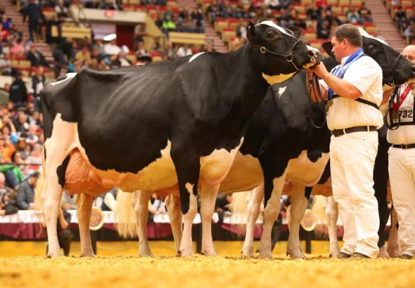
Continual Improvements in Genetics

Slide 52
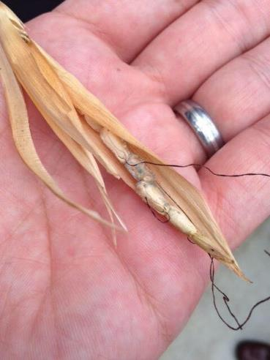
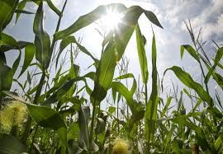
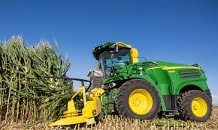
Continual Improvements in Genetics

Slide 53
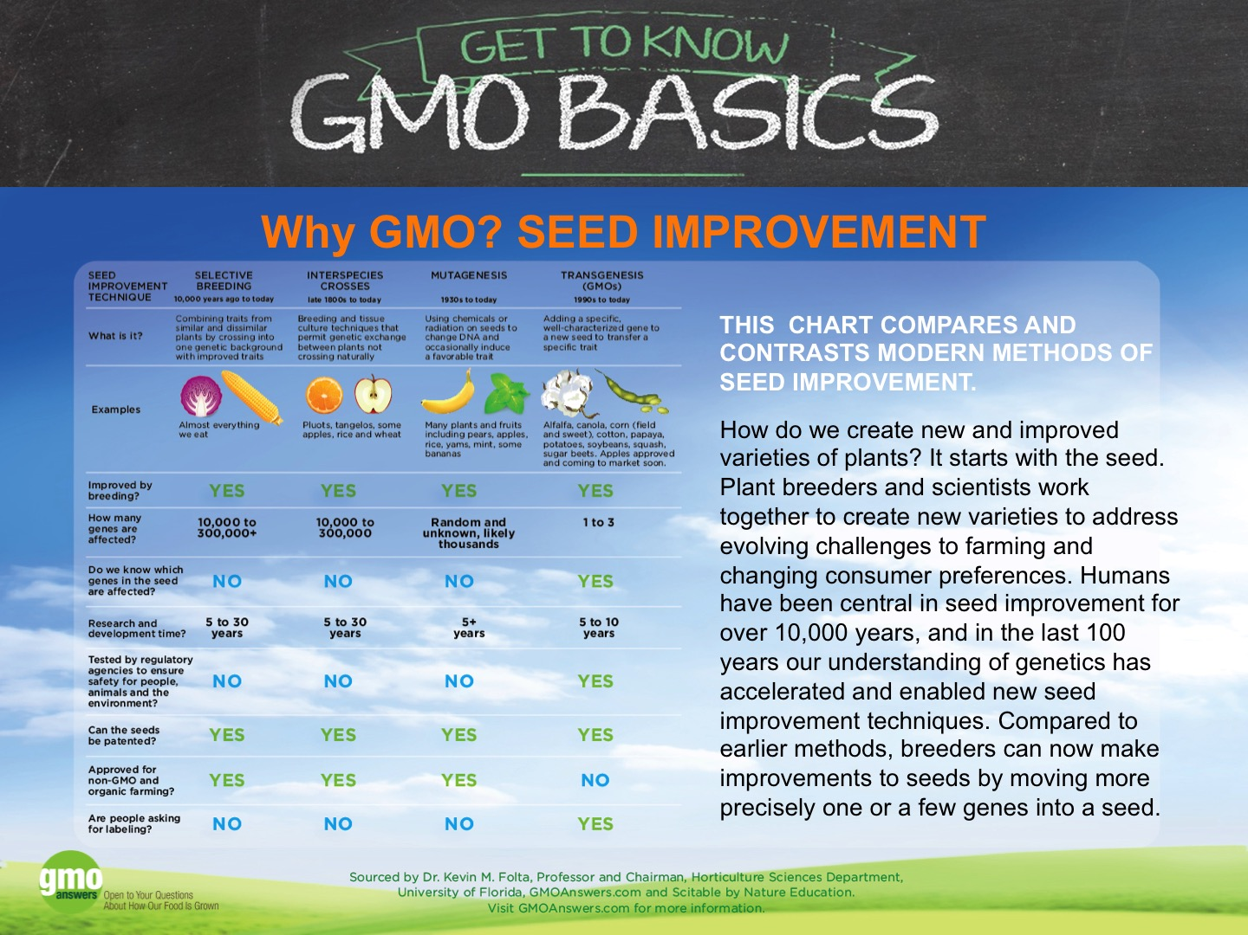
Continual Improvements in Genetics

Slide 54
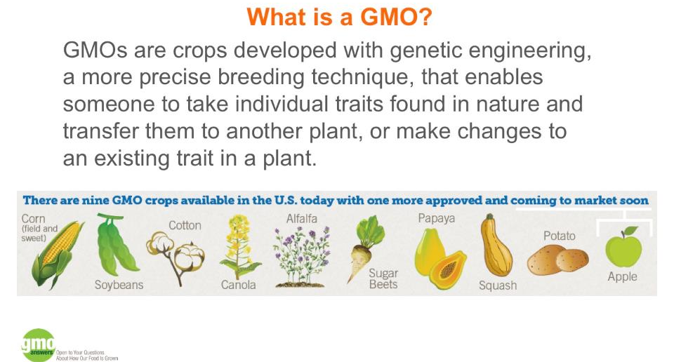
Continual Improvements in Genetics

Slide 55
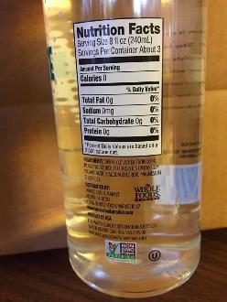
Continual Improvements in Genetics
What are they not?

Slide 56
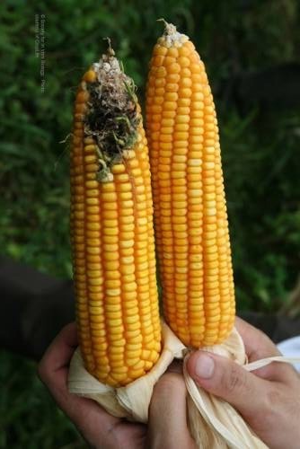
Continual Improvements in Genetics
GMO’s are a TOOL…
Prevent Plant Disease
Control Insects
Manage Weeds
Combat Drought

Slide 57
Continual Improvements in Genetics
GMO’s are a TOOL…
Prevent Plant Disease
Control Insects
Manage Weeds
Combat Drought
Healthy Plants Make Healthy Food!

Slide 58
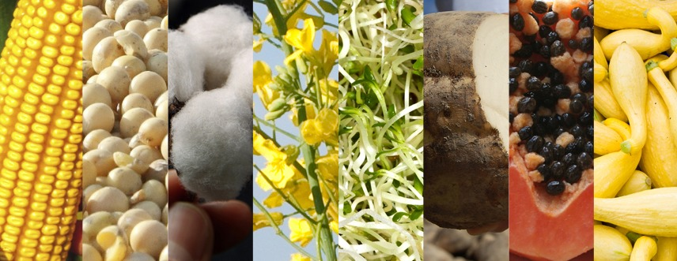
Continual Improvements in Genetics
Key Concerns
“Scary”
“Environmental Footprint”
“Not Natural”
“Not Safe”

Slide 59

Continual Improvements in Genetics
- 407 pages
- 18 world renowned, respected scientists and researchers
- 28 reviewers
- 30 pages of comments and reviews

Slide 60
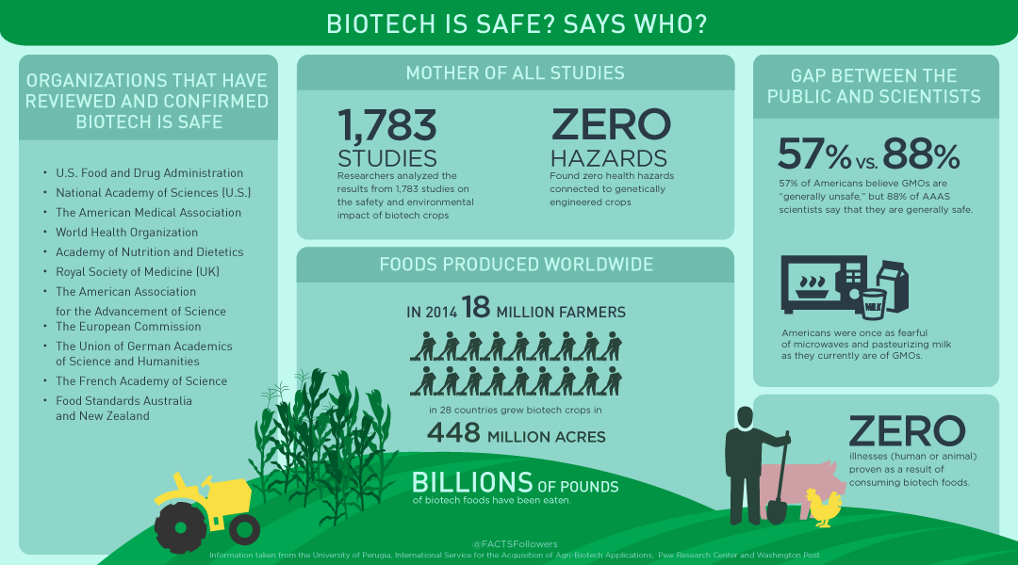
Over 90 regulatory agencies worldwide and
70+ countries have approved them
for growing and eating.

Slide 61
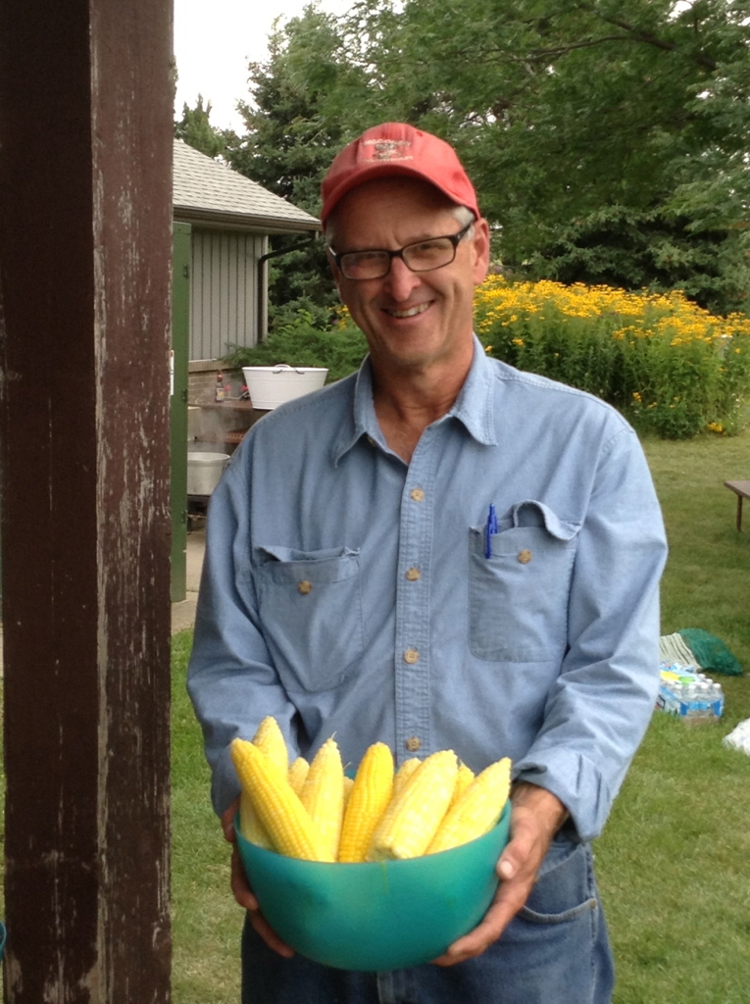

Continual Improvements in Genetics
Nation’s FIRST
Endowed Chair for
Organic Plant Breeding
~Bill Tracy~
- 5 sweet corn cultivars
40+ graduate students

Slide 62
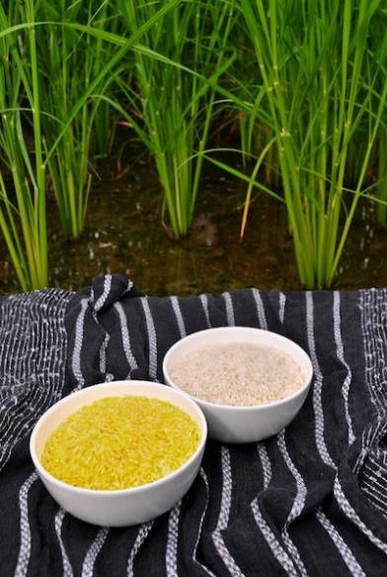
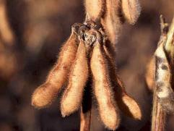
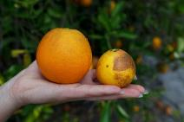
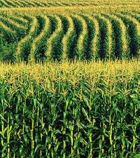

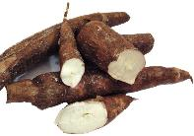
The Future?

Slide 63
The Future?
CRISPR

Slide 64
Sustainable Practices
Continual Improvements in Genetics
Continual Improvements in
Animal Welfare
Continual Improvements in
Cropping Practices

Slide 65




Continual Improvements in Animal Welfare
Cow Comfort
Consortium

Slide 66

Continual Improvements in Animal Welfare
VFD
Veterinary
Feed
Directive

Slide 67



Continual Improvements in Animal Welfare

Slide 68
Sustainable Practices
Continual Improvements in Genetics
Continual Improvements in
Animal Welfare
Continual Improvements in
Cropping Practices

Slide 69

Continual Improvements in Cropping Practices
Farm Conservation Ag Strategies:
Nutrient Management Plans
No till, minimum till,
conservation tillage
Crop rotation
Cover crops
Split N applications
Buffers
Wetlands
Bioreactors
Plant genetics
LD manure injection
Precision Agriculture!

Slide 70
Continual Improvements in Cropping Practices
Place-Based
Farming Decisions
Stop the focus on specific practices/types of agriculture…
20,000 soil types
21 watershed zones
13 plant hardness zones
WEATHER
Source:U.S. Geological Survey 2018, USDA Ag Research Service

Slide 71

Continual Improvements in Cropping Practices
#factsnotfear
“It’s the dose that makes the poison.”
The Talk vs. The Truth

Slide 72
Never Stop Learning
Resources:
fooddialogues.com.
milktruth.com
gmoanswers.com
geneticliteracyproject.org
kfolta.blogspot.com
bestfoodfacts.org
betterseed.org
biofortified.org
enoughmovement.com
bovidiva.com
foodinsight.org
The KNOW GMO Project on youtube.com (Rob Saik)
AND EACH OTHER!

Slide 73
Action Plan
168

Slide 74


Action Plan
168

Slide 75


Action Plan
168

Slide 76


Action Plan
168

Slide 77

www.discoveringfarmland.com
168

Slide 78

foodevolutionmovie.com
Available on HULU
and iTunes
Licensing agreement
with USFRA
Host a screening or
panel discussion…
Contact Jenny Johnson
for more details
636-449-5049
jjohnson@usfraonline.org

Slide 79


Action Plan
168

Slide 80

Action Plan
168

Slide 81

Action Plan
168

Slide 82












Slide 83
You Own the Message that Matters
How we are always improving the care for the land…
How we are always improving the care for your animals…
How we are always improving to conserve resources…

Slide 84
Be the Leaders!

Slide 85

Any Questions?
kim@aginspirations.com
Cell: 715-797-7796
www.aginspirations.com

