Slide 1
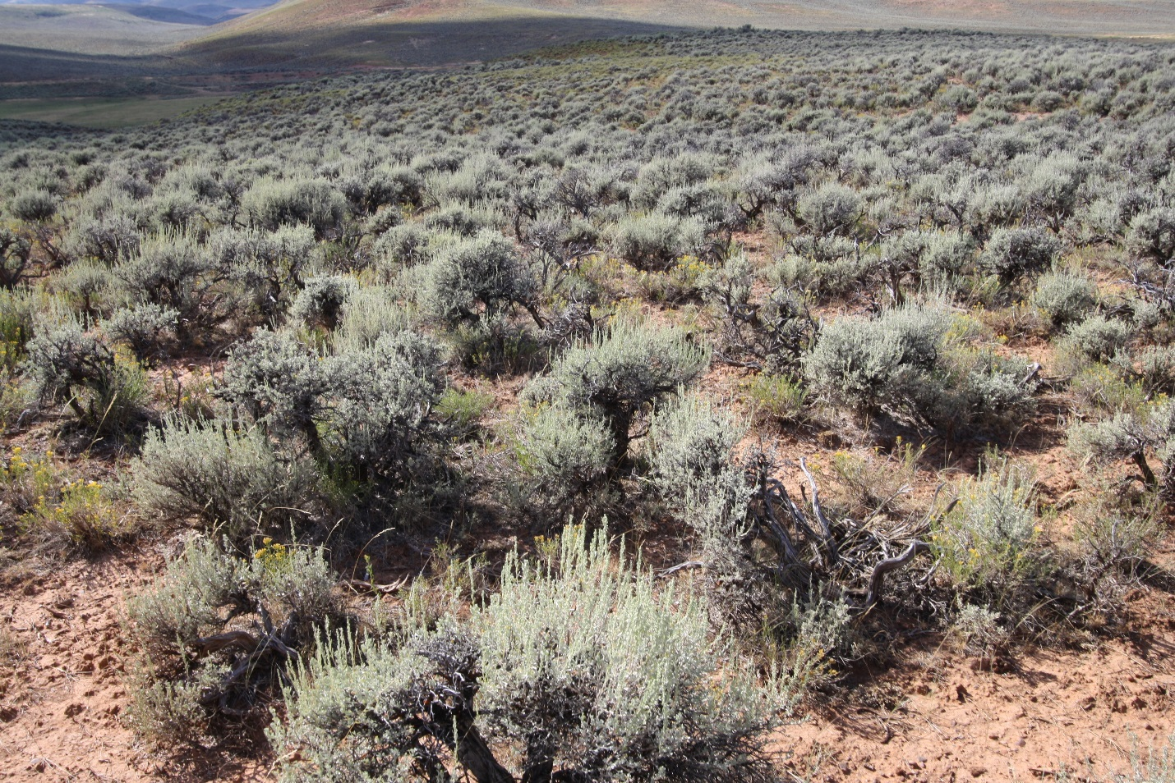
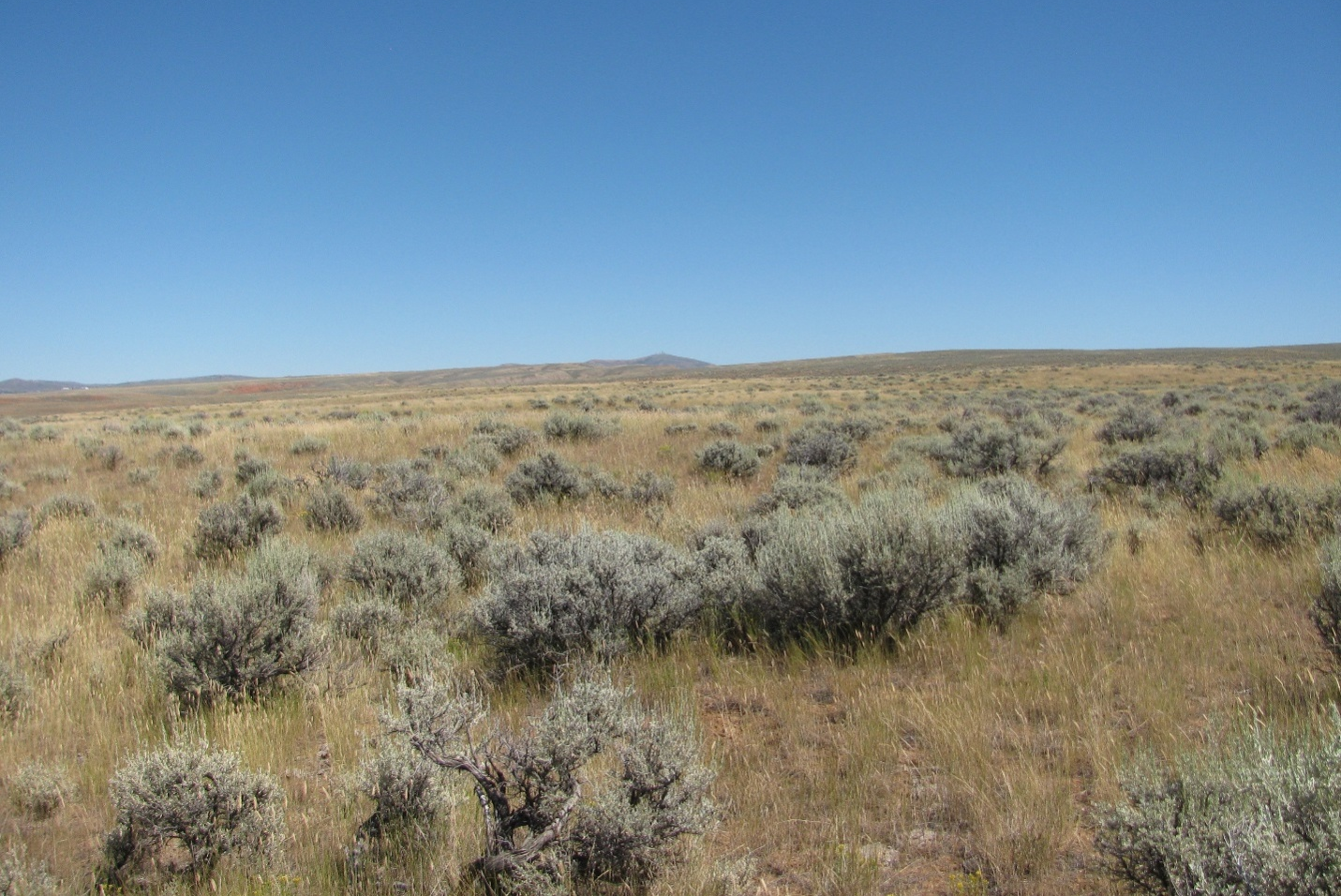
A Rangeland Assessment Method:
Comparing Two Grazing Systems
Open Range Consulting (ORC)
Gregg Simonds & Eric Sant
October, 2013

Slide 2
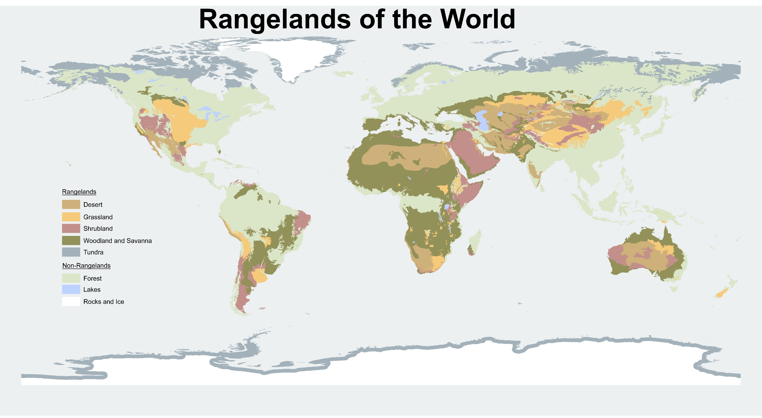
Food and Fiber
Water Security
Carbon Cycle
University of Idaho, Karen Launchbaugh and Eva Strand, with input from the SRM I&E committee.

Slide 3
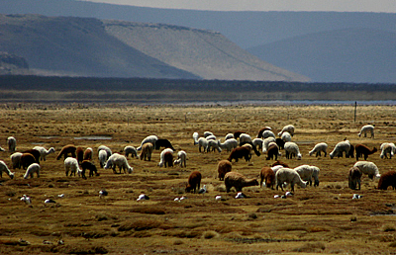
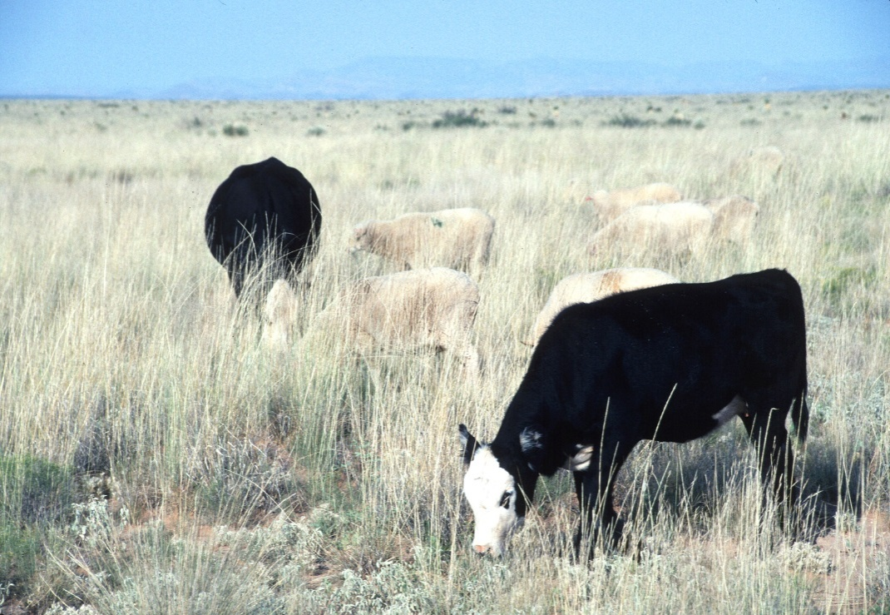
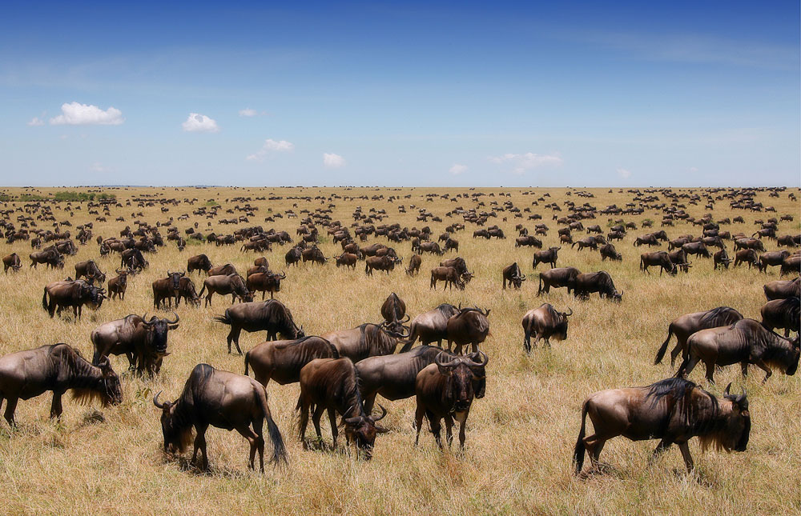
Grazing is Ubiquitous
Cost Effective and Statistically Valid Monitoring a Must

Slide 4

Historical Rangeland Assessment
Notes:
Historical rangeland monitoring methods take a few detailed samples in a landscape. This can not overcome spatial and temporal variation to see the big picture
These samples have a lot of detailed measurements on these few sites but these samples can’t be extrapolated to the surrounding landscape.

Slide 5
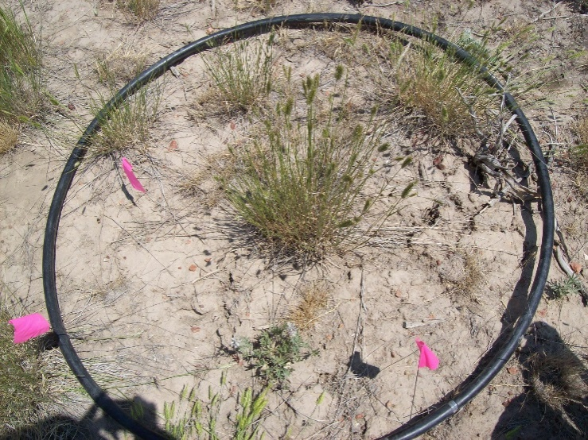
Historical Rangeland Assessment
Historical Landscape Assessment
Notes:
Spatially Limited
The response to the problem of seeing the entire picture is to zoom in closer on each dot
If you measure that dot with much finer detail, does it help you see the entire picture?

Slide 6
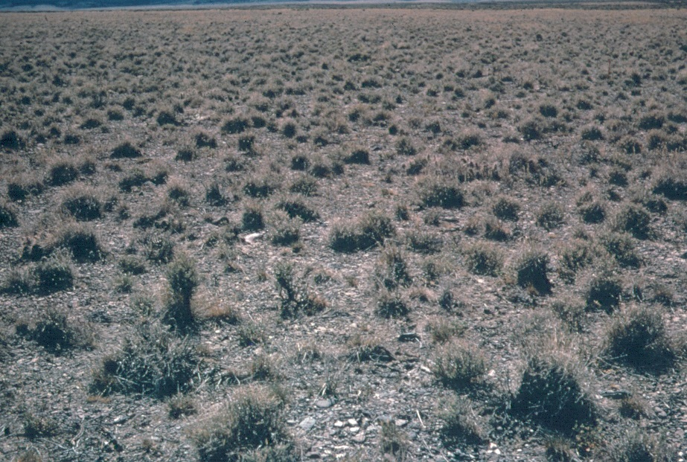
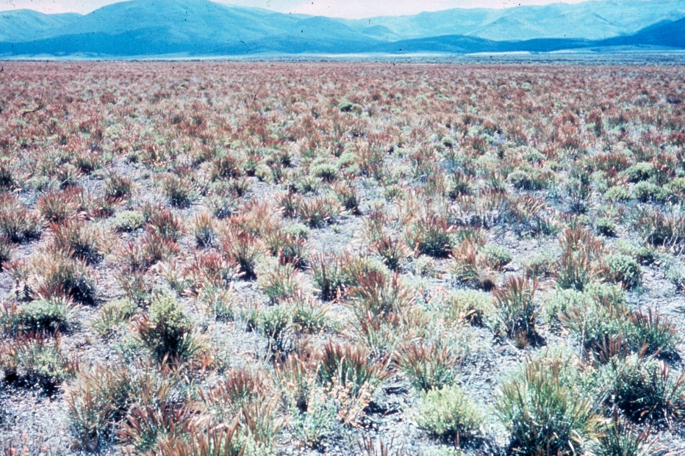
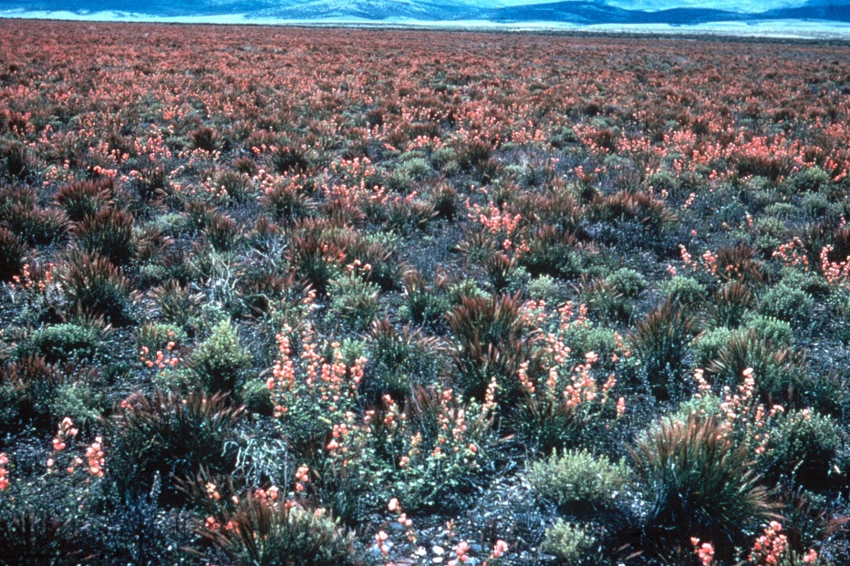
Historical Rangeland Assessment
1966
1965
1964
Lee Sharp, 1990
Notes:
Temporally Limited
Additionally, by intensifying our efforts on that one dot are we capturing the year to year differences of if and when it rains
Photos will flash up-if you assessed the hula hoops in these consecutive years you would assume that grazing has been bad-These photos are part of a long term exclosure that has had no grazing.

Slide 7
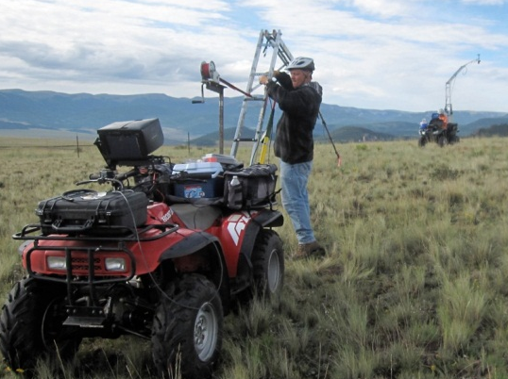
ORC’s Rangeland Assessment
Historical Landscape Assessment
Notes:
We take lots of samples
Sacrifice species level detail for spatial richness
Focused on important range sites and vegetation

Slide 8
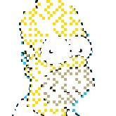
ORC’s Rangeland Assessment
Historical Landscape Assessment
Notes:
With a high degree of spatial richness
-you can start to see from the dots/pixels what the image is of

Slide 9

ORC’s Rangeland Assessment
Historical Landscape Assessment
Notes:
Because satellites and airplanes are taking images and because the ground samples can be correlated with those images
-the areas that were not sampled can be filled and the entire picture can be seen.

Slide 10

ORC’s Rangeland Assessment
Historical Landscape Assessment
Notes:
So instead of just samples we now have a quantitative measurement for every piece of the picture.

Slide 11



ORC’s Rangeland Assessment
Historical Landscape Assessment
Notes:
And because the satellites have been going around since 1972 we can see the different phases of home

Slide 12
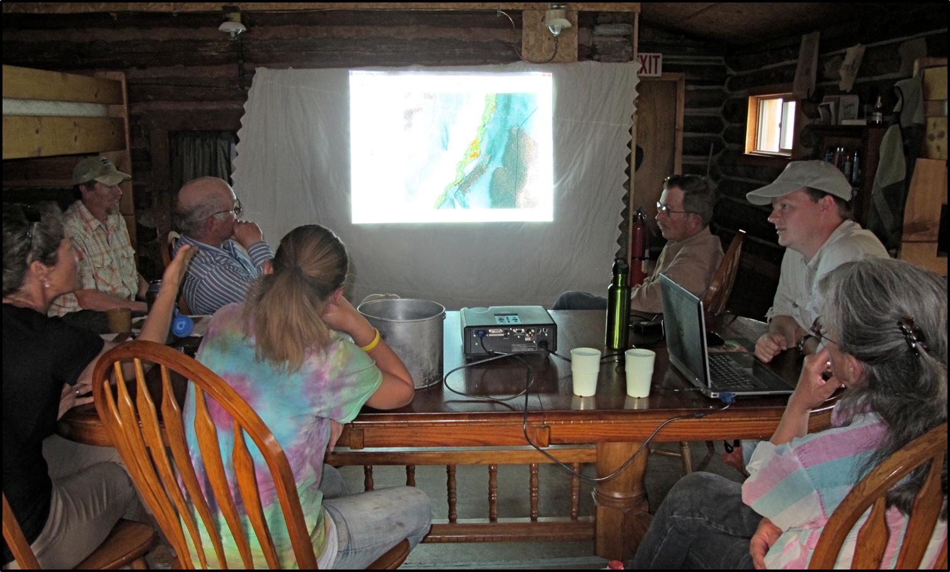
ORC’s Rangeland Assessment
Homer
Rancher
Cowboy
Resource
Specialist

Slide 13
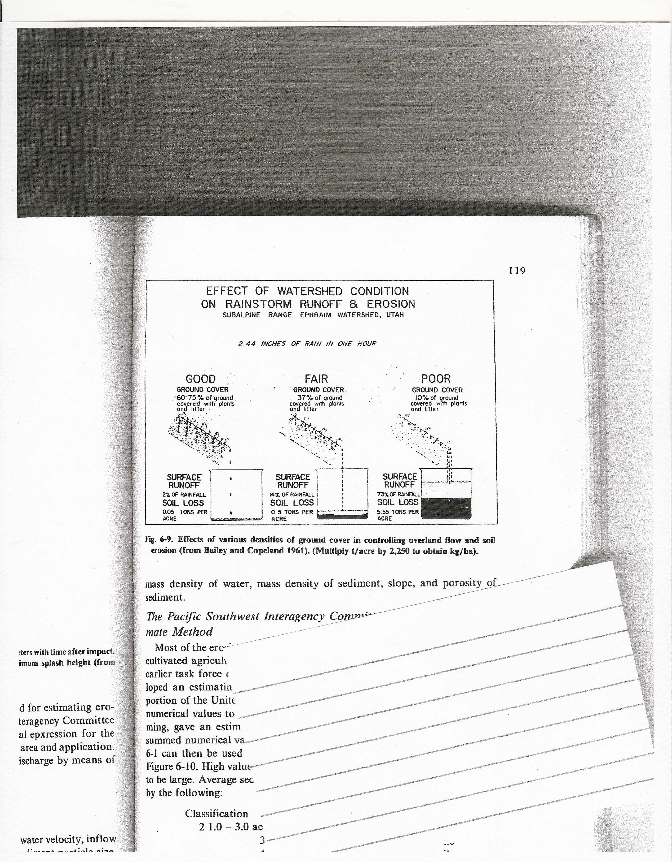
Focus on Functional Cover Types
Bare Ground
Herbaceous
Litter
Shrubs
Notes:
Whether water is tending to go in the ground or over the ground determines it’s utility. When it go into the ground it supports plant growth, become purified and is more slowly released and /or goes into deep aquifers (as a deposit). Amount of bare ground not only has a huge effect on plant production for livestock and wildlife but it effects society and industry. For instant; it will effect whether a reservoir has blue or brown water, trout of trash fish, how long the reservoir lasts, how efficient power is generated and need for water treatment and supply

Slide 14
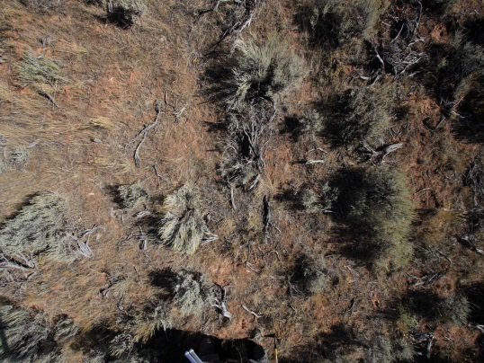
Upland Assessment
High Resolution Photos
On-The-Ground
6x7 m 2mm
18 Million Pixels

Slide 15
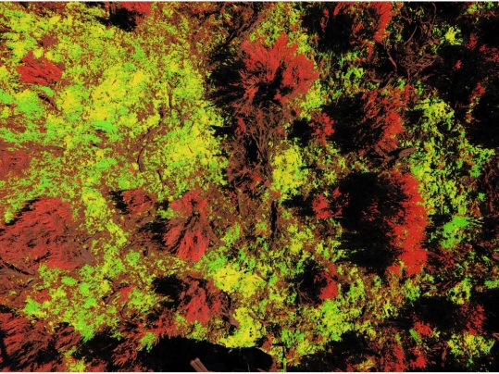
Upland Assessment
High Resolution Photos
On-The-Ground
Bare Ground
Herbaceous
Litter
Shrubs
6x7 m 2mm
18 Million Pixels

Slide 16
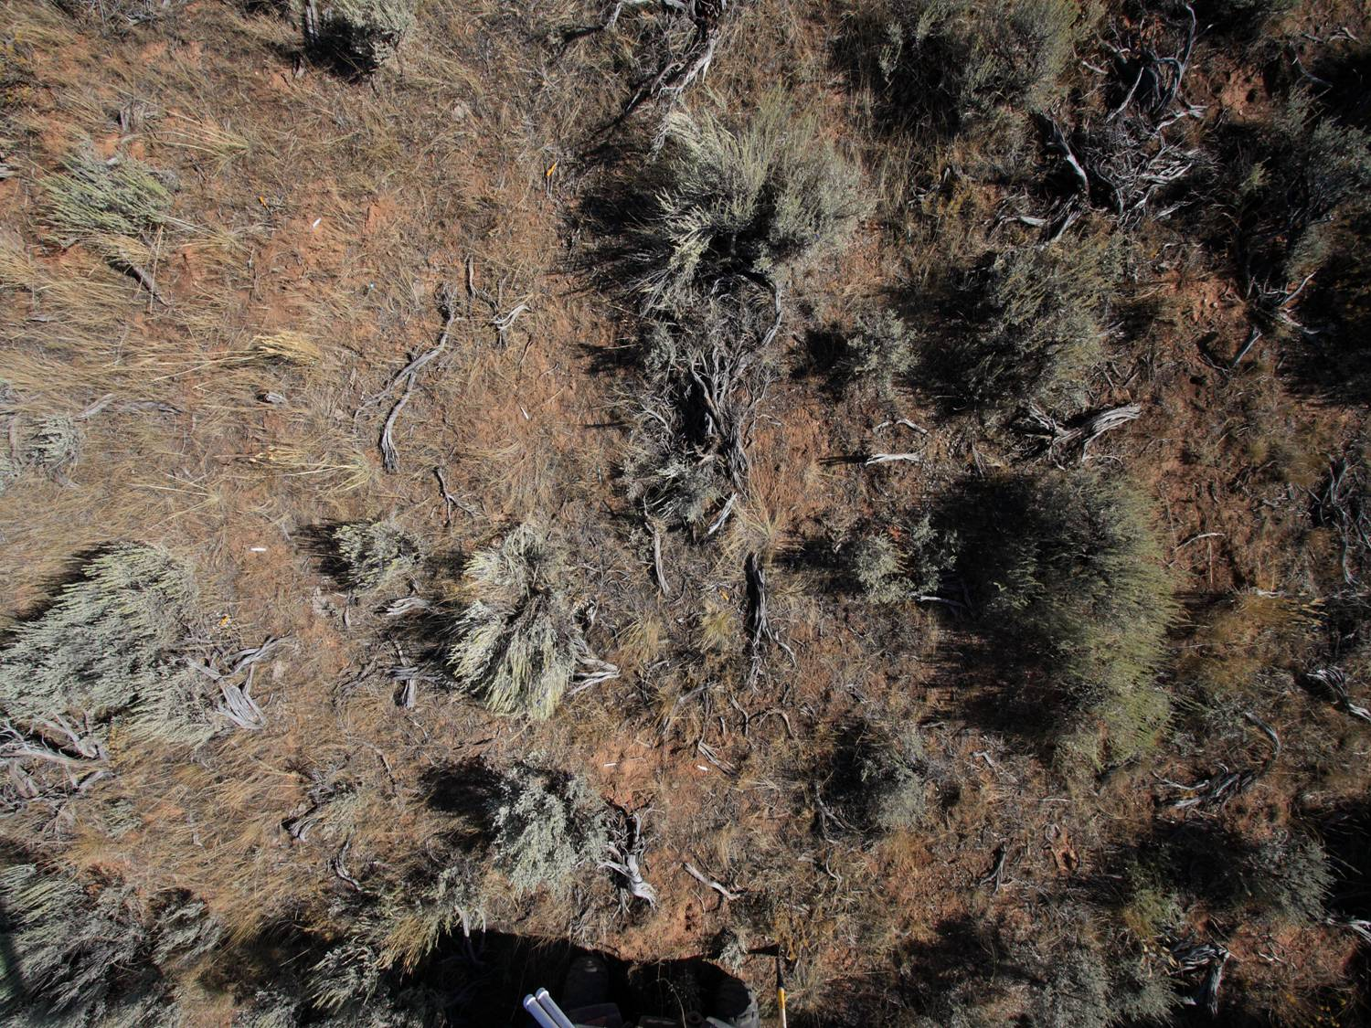
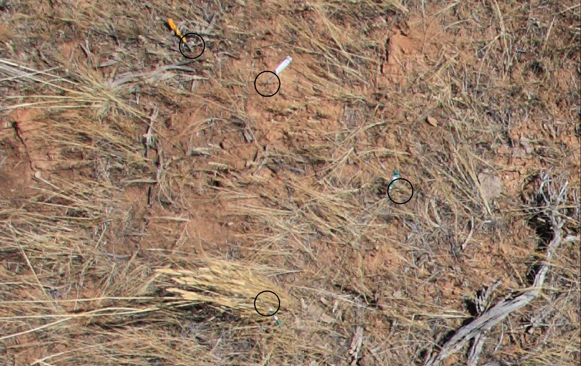
Notes:
6x 7 M 18mil bits

Slide 17
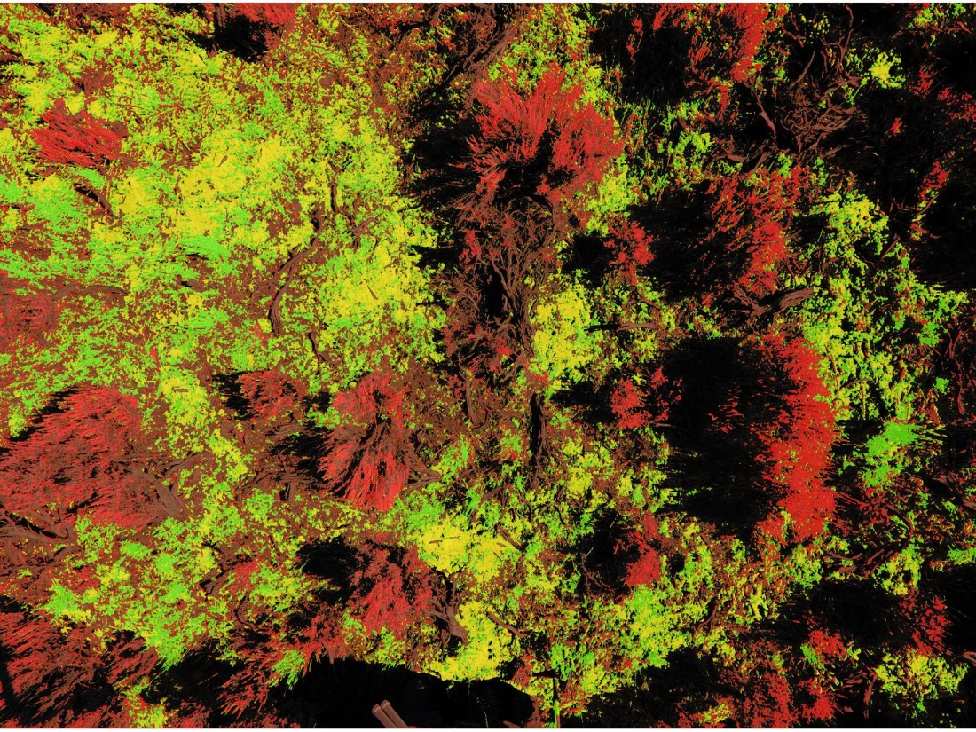
Bareground | 99%
Herbaceous | 92%
Litter | 95%
Shrub | 90%

Slide 18
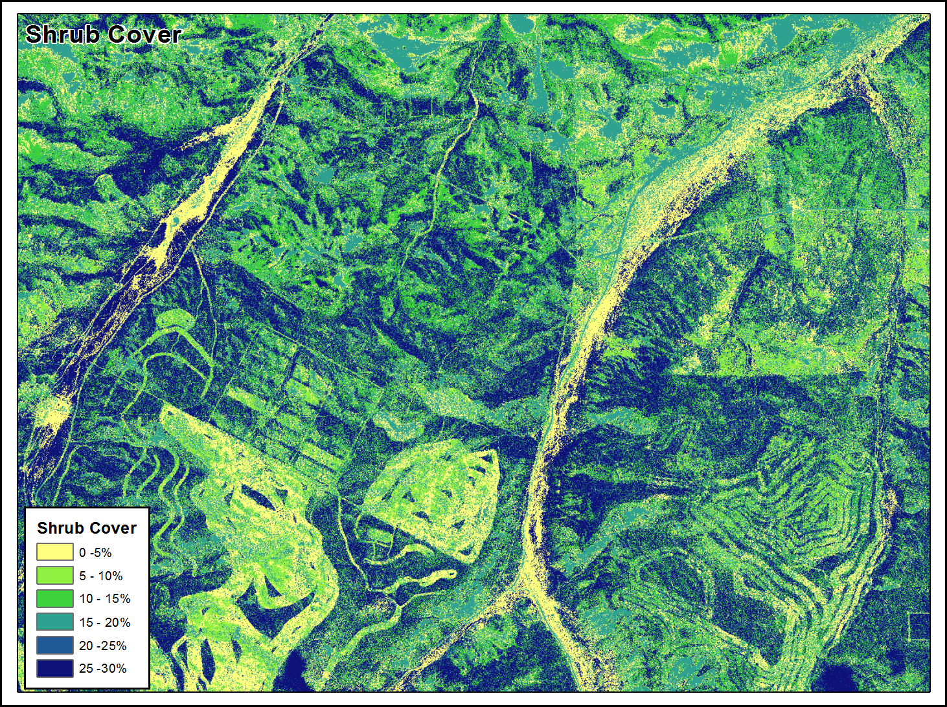
1m Accuracy | R²
Bareground | 0.92
Herbaceous | 0.89
Litter | 0.85
Shrub | 0.91
Notes:
Continuous cover mapping results in every 1 meter square across the landscape have a percent cover value of bg, litter, shrub, and herbaceous

Slide 19
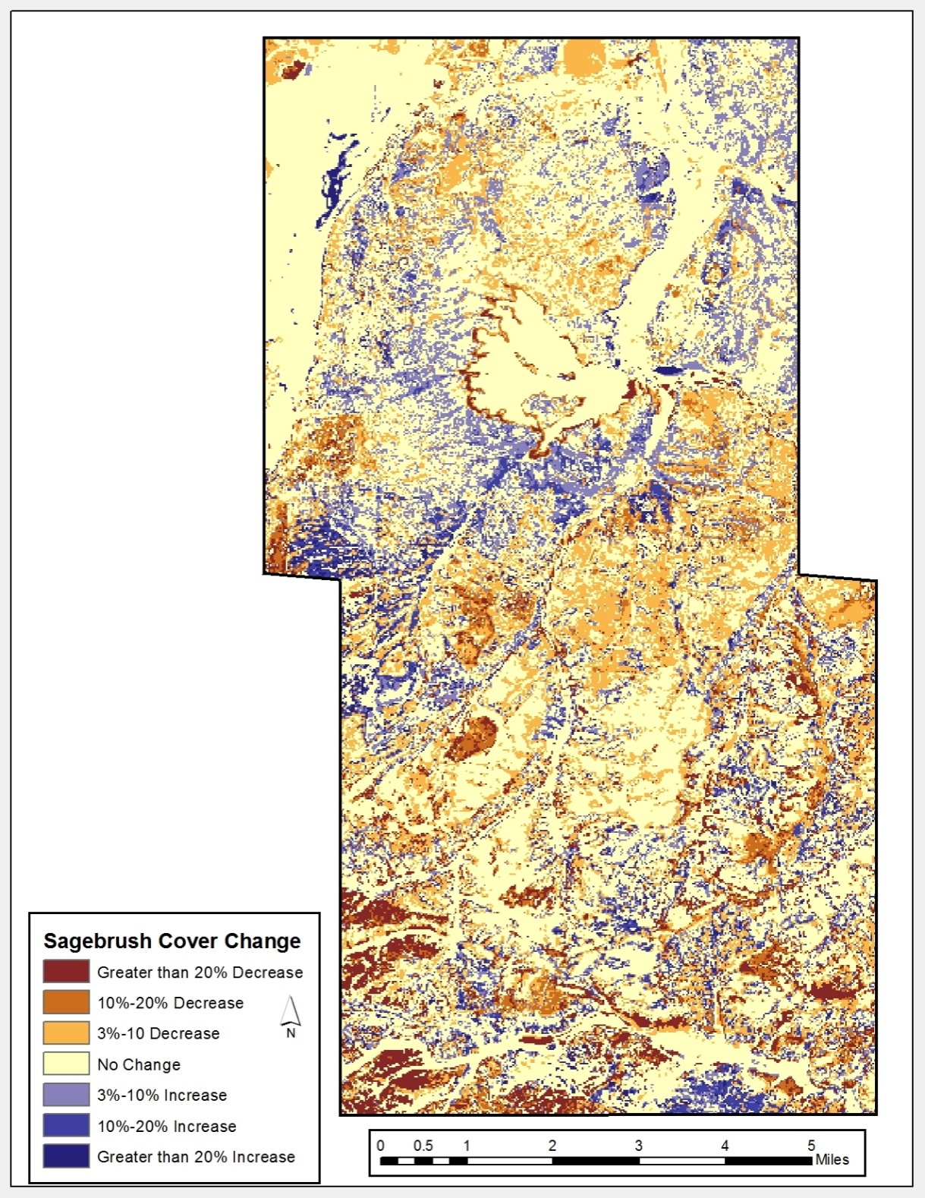
Shrub Cover Change 1995-2010

Slide 20
Riparian Assessment
Focus on Important Functional Ground Cover
Upland Veg.
Bare Ground
Riparian Veg.
Water

Slide 21
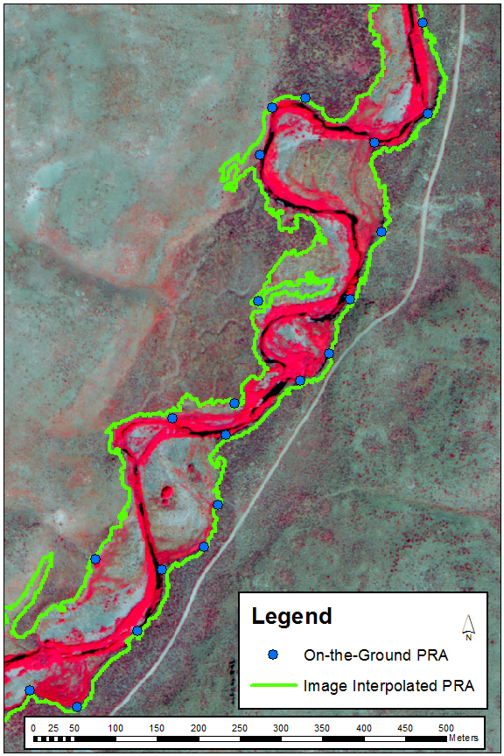
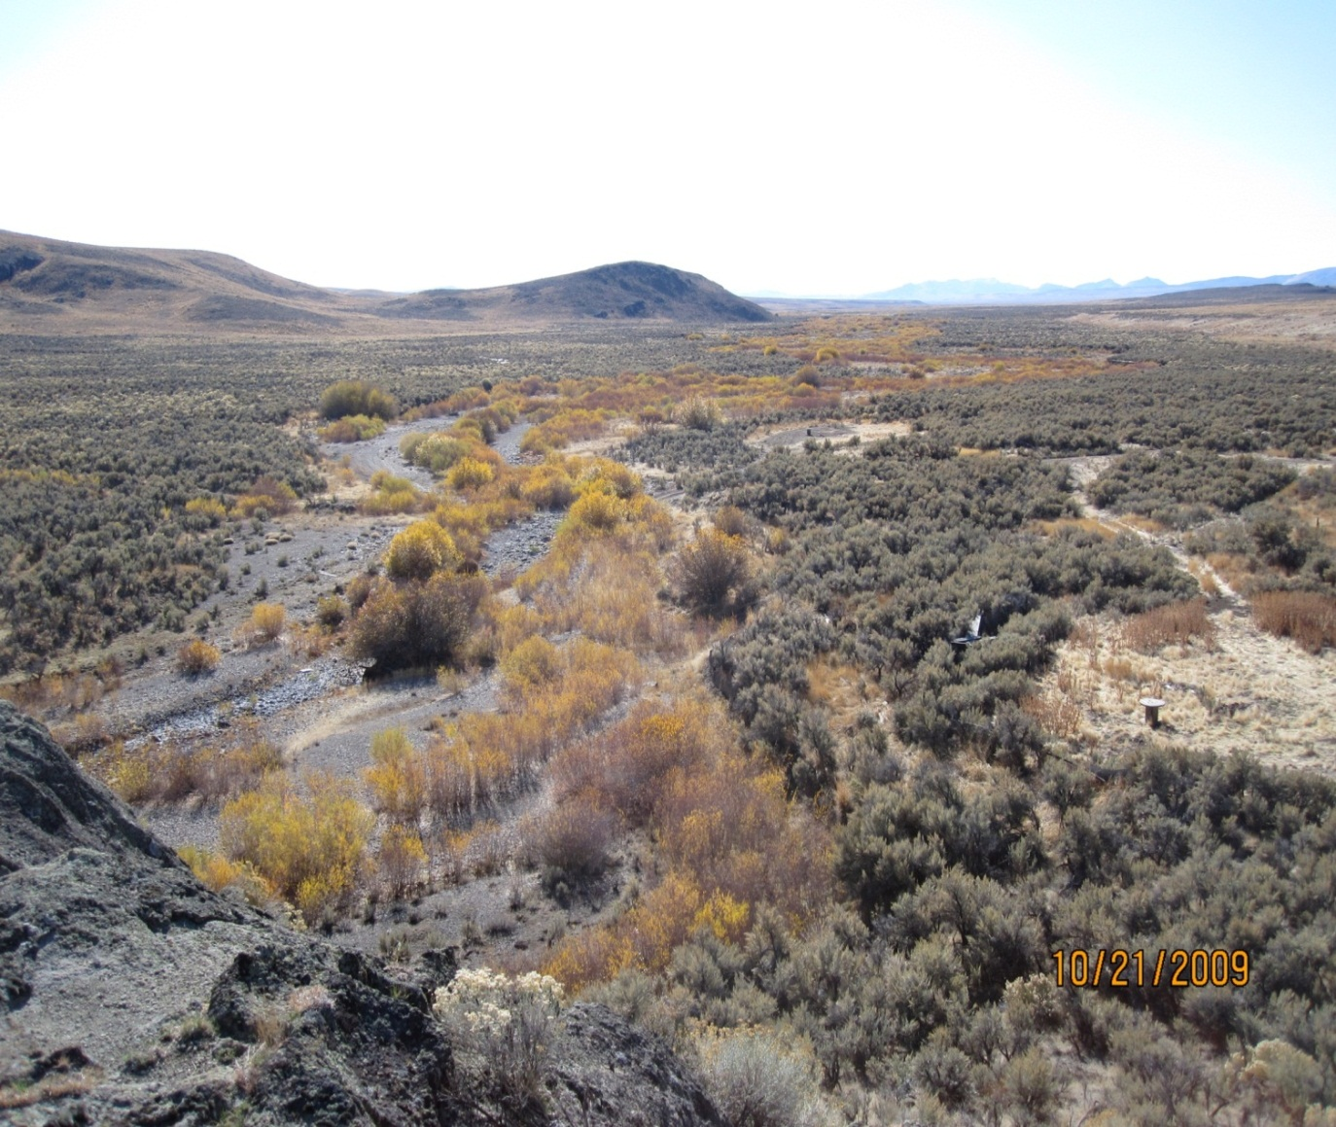
Assess Within the
Potential Riparian Area (PRA)

Slide 22
Increasing Riparian Vegetation Within the PRA
Correlated to Positive Changes in the
Following Riparian Indicators
Water
Table
Fish
Populations
Water
Temperature
PFC
Sediment

Slide 23
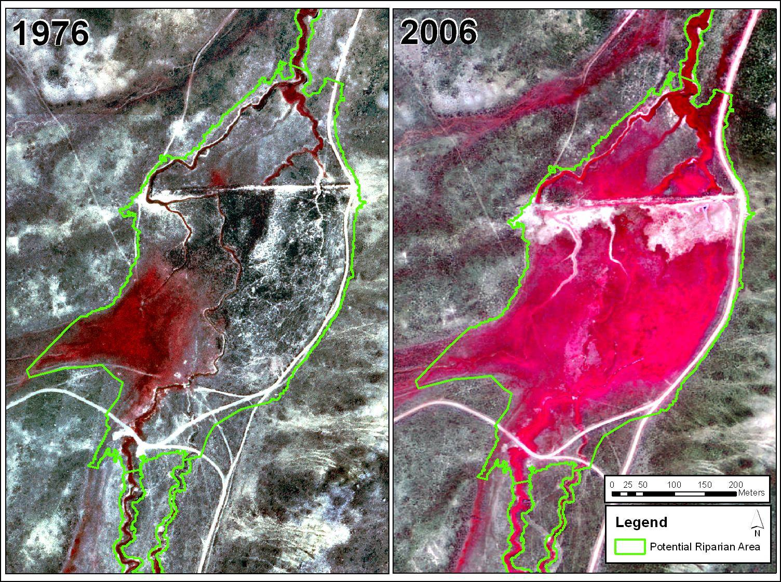

Slide 24
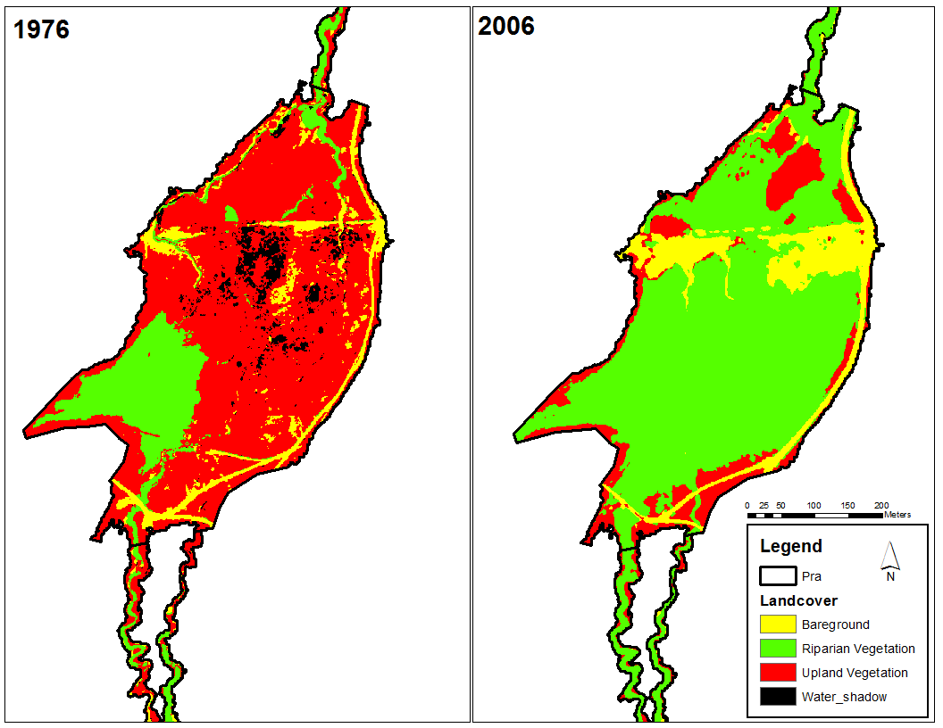

Slide 25
Three Creeks vs. DLL Comparison

Slide 26
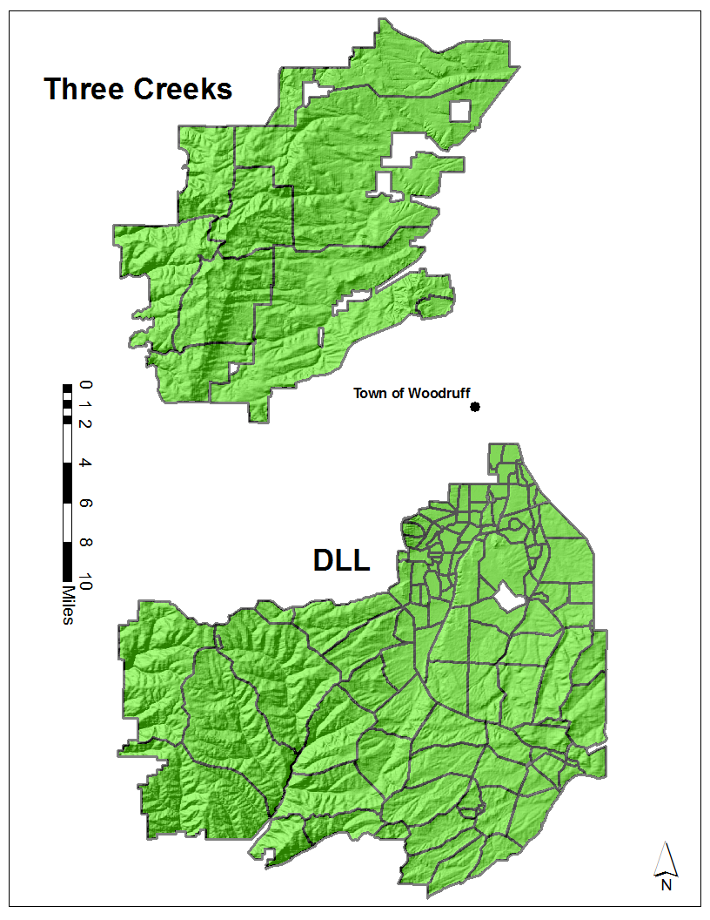
Physically Similar
Elevation
1928m-2270m
Climate Woodruff Weather Station
24cm Annual Precipitation
Average low 18°
Average high 28 °
Different Management
DLL
Mostly Private
Adaptive, Time Controlled (1976)
4.4 Acres/AUM
Three Creeks
Mostly Public
Season Long Grazing
6.75 Acres/AUM

Slide 27
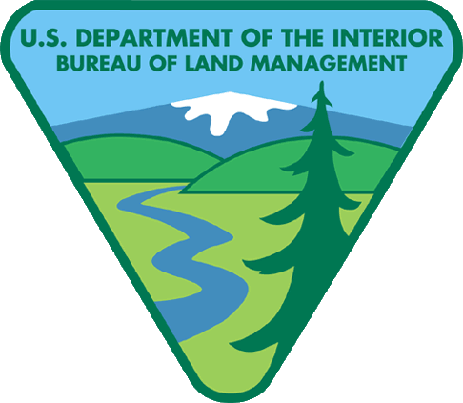

Standards and Guidelines
1. Sufficient cover and litter to protect the soil surface from excessive water and wind erosion, promote infiltration, detain surface flow, and retard soil moisture loss by evaporation
USFS Objectives for Range Management
1. Manage range vegetation to protect basic soil and water resources

Slide 28
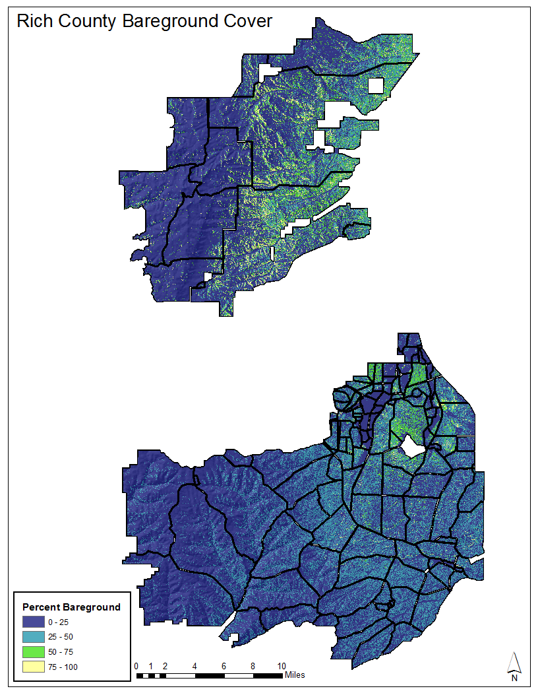
DLL
Three Creeks
Notes:
----- Meeting Notes (10/11/13 09:02) -----
Within the sage-grouse habitat (perrenial grass, Tall (deep soils) and Short (shallow soils)
Analyzed the amount of bare ground, which a key functional component of rangeland

Slide 29
Semi-Desert Loam
NRCS ESD: Bare Ground Ranges from 25% - 35%
28%
36%
DLL
3 Crks
15%
20%
25%
30%
35%
40%
Notes:
----- Meeting Notes (10/11/13 09:02) -----
To make the comparison of site better we compared the soil site that both had a lot of .
On the same soil types the differences have the same tendency.

Slide 30
Standards and Guidelines
2. Riparian and wetland areas are in properly functioning condition….

Slide 31
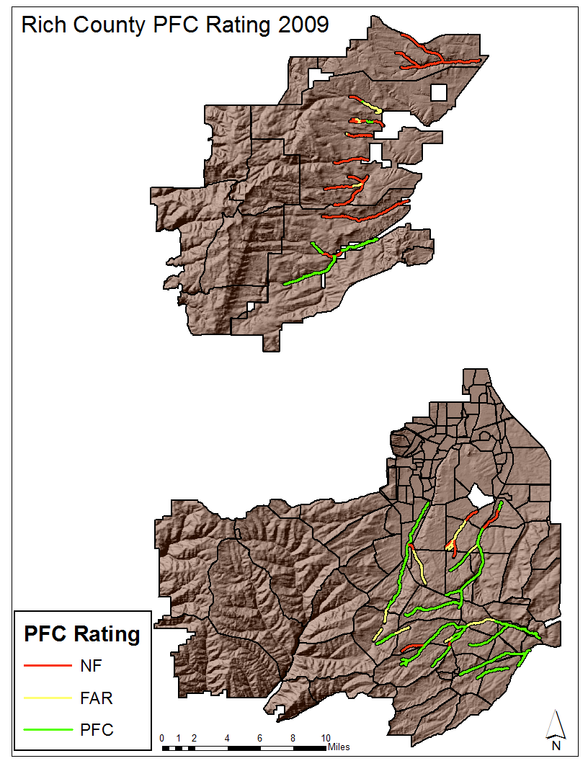

Slide 32
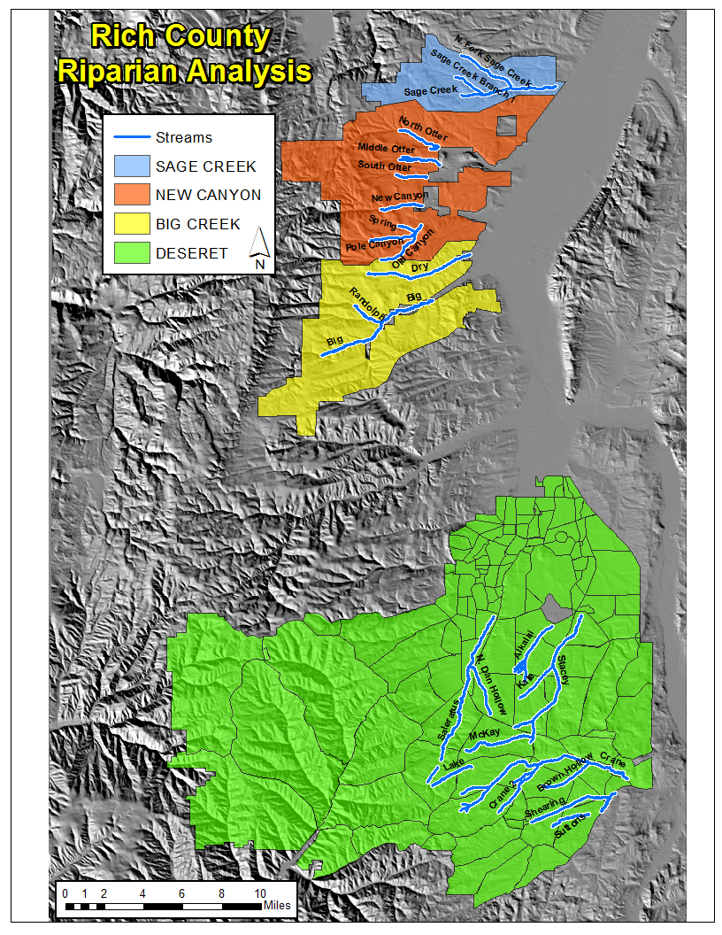

Slide 34
Questions & Comments
Notes:
Sum up the points made in the introduction

