Slide 1


Shannon Neibergs Director Western Center for Risk Management Education Washington State University
ERME and Farm Business Management Education Emerging Extension Risk Management Education Issues
and Opportunities in Agriculture

Slide 2
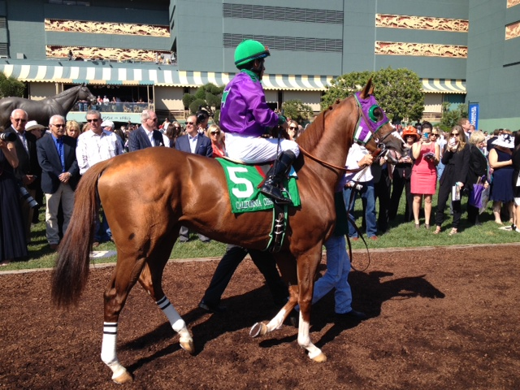


California Chrome
Notes:
Finished tied for fourth in a field of 11

Slide 3
California Chrome Pedigree
Notes:
Seatlle slew in1977 and affirmed in 1978,
Seattle slew 1974 to 2002
AP Indy $300,000 stud fee down to $150,000
Mr Propsector stud fee over $300,000
Pulpit $60,000 stud fee

Slide 4
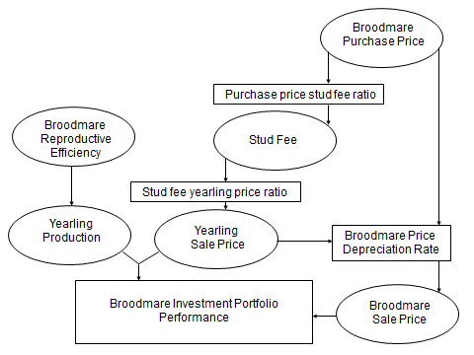
Broodmare Investment Portfolio
Notes:
Discuss portfolio from investor perspective

Slide 5
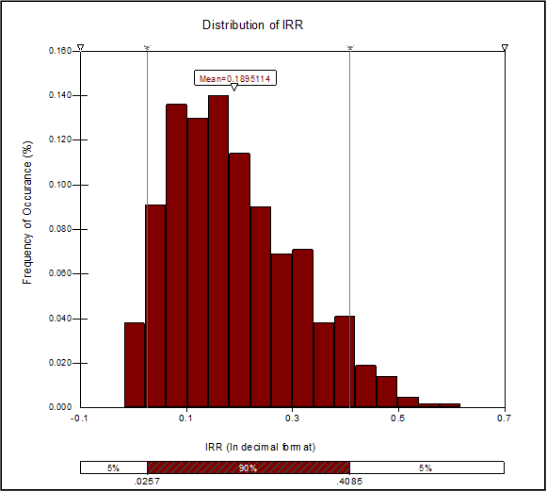
Distribution of Broodmare Portfolio IRR
Mean =
18.95%

Slide 6
Broodmare Investment Portfolio
Notes:
Discuss portfolio from farm perspective

Slide 7
Points from this discussion
Fundamental to understand the inter-relationships within an industry/business to make management recommendations.
Increasingly important to analyze risk using approaches that take into account the risk variance and multiple year time frame.
eg. 2014 Farm Bill ARC and PLC programs are for the life of the Farm Bill
Decision aids are becoming more data intensive
Decision aids need to be site specific
Notes:
ARC agriculture risk coverage, price loss coverage plc
Transition to discussion of more traditional agriculture here are some points to take from the broodmare investment discussion.

Slide 8
Risk in Agriculture
Risk in agriculture has increased
Increased price volatility
Increased yield variability – weather
Increased food safety liability
gmo trade restrictions
Increased financial risk
Tools to manage risk have improved
Rapid growth in USDA RMA insurance products
2014 Farm Bill redesign towards insurance based programs
Dairy MILC → Margin Protection Program
Direct payments → ARC and PLC
Notes:
Record high prices in milk - $25/cwt,
Record high price of beef
Highly volitile price in sheep
Corn – soybean price variablity – low corn strengthing soybeans.
Food safety – spinach 2006 ecoli, peanut butter salmonella, cantelop listeria,
But gmo – wheat and Japan,

Slide 9
Expanded use of insurance
Expanded Use of Crop Insurance – Corn by Acres Insured
Source: farmdoc, Farmland Markets, May 30, 2014
Notes:
Record high prices in milk - $25/cwt,
Record high price of beef
Highly volitile price in sheep
Food safety – spinach 2006 ecoli, peanut butter salmonella, cantelop listeria,
But gmo – wheat and Japan,

Slide 10
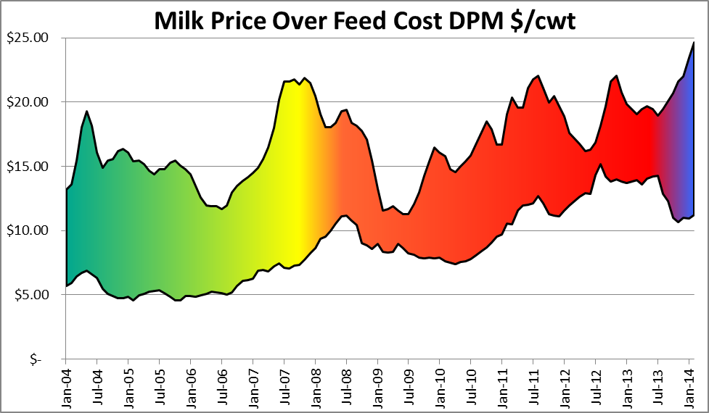
Dairy Margin Protection Program
Notes:
1.0728 * NASS corn price / bushel
+ 0.00735 * AMS central Illinois soybean meal price / ton
+ 0.0137 * NASS alfalfa hay price / ton
= National Average Feed Cost

Slide 11
Dairy MPP Premiums
Table 1. Schedule of Premiums.
Margin Coverage Level | Premium First 4 Million Pounds $/cwt | Premium Over 4 Million Pounds $/cwt
$4.00 | Free | Free
$4.50 | $0.010 | $0.020
$5.00 | $0.025 | $0.040
$5.50 | $0.040 | $0.100
$6.00 | $0.055 | $0.155
$6.50 | $0.090 | $0.290
$7.00 | $0.217 | $0.830
$7.50 | $0.300 | $1.060
$8.00 | $0.475 | $1.360
Notes:
4 million pounds of production = 200 head dairy using national average per cow milk production

Slide 12
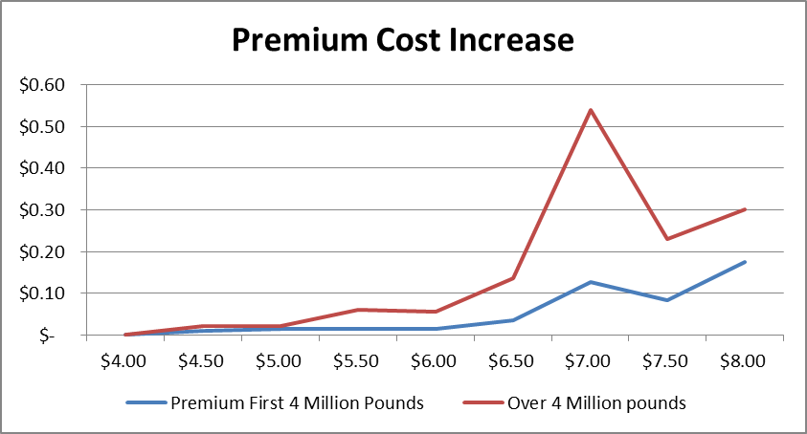
Dairy MPP Premium Marginal Cost
Notes:
Mc = 0.54 mb =0.50

Slide 13
Dairy MPP Payment Likelihood
Table 2. Likelihood of MPP Payments 2008-2013.
Margin Coverage Level | Jan-Feb | Mar-Apr | May-Jun | Jul-Aug | Sep-Oct | Nov-Dec | Total
$8.00 | 67% | 67% | 67% | 67% | 33% | 50% | 58%
$7.50 | 50% | 67% | 50% | 50% | 33% | 0% | 42%
$7.00 | 50% | 50% | 50% | 50% | 33% | 0% | 39%
$6.50 | 50% | 50% | 50% | 50% | 17% | 0% | 36%
$6.00 | 33% | 50% | 50% | 50% | 17% | 0% | 33%
$5.50 | 17% | 33% | 50% | 33% | 0% | 0% | 22%
$5.00 | 17% | 33% | 33% | 33% | 0% | 0% | 19%
$4.50 | 17% | 33% | 33% | 33% | 0% | 0% | 19%
$4.00 | 17% | 17% | 33% | 33% | 0% | 0% | 17%

Slide 14
Dairy MPP Loss Ratios
Table 3. Loss Ratios Jan 2008 - Dec 2013
Coverage level | 200 Head | 480 Head | 5000 Head
 | 40,000 Cwt | 113,880 Cwt | 1,186,250 Cwt
$8.00 | 2.87 | 2.14 | 2.02
$7.50 | 3.70 | 2.30 | 2.11
$7.00 | 4.18 | 2.43 | 2.20
$6.50 | 7.95 | 5.37 | 4.97
$6.00 | 9.97 | 7.54 | 7.11
$5.50 | 10.13 | 8.46 | 8.13
$5.00 | 10.22 | 13.85 | 15.20
$4.50 | 20.93 | 20.93 | 20.93
$4.00 | 54.37 | 255.23 | 3170.64
Notes:
Loss ratios very effective
But the education and the management decision Must center around the net cash flow provide my MPP decisions and risk management – debt repayment needs of the dairy.
NOW if not before discuss insurance programs not only for the farmer/producer but for the SUPPORTING industries. Need to keep the infrastructure whole!

Slide 15
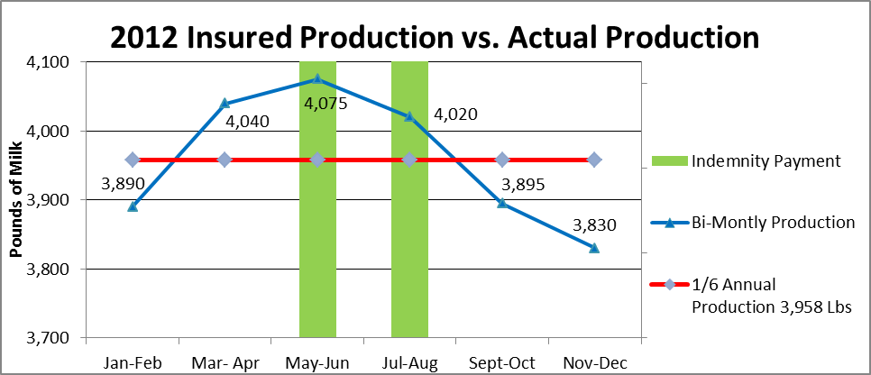
Seasonality and Dairy MPP - WA
Notes:
Washington State had its highest production during this time in 2012 with 23,750 pounds/cow or 3,958 pounds per bi-monthly period. Figure 2 uses the blue line to represent the actual seasonal bi-monthly production for the typical Washington dairy cow, ranging from 3,830 to 4,075 pounds of bi-monthly production. The red line represents insurable production (1/6th of the annual production, 3,958 lbs.). Peak seasonal production is May-June at 4,075 pounds/head (blue line) which is 117 pounds per cow or 2.8% above the fixed insurable production. If the producer has elected 90% coverage, he will be covered for 87 % of his actual production for these two months. Conversely, the 3 bi-monthly periods: Jan-Feb, Sept-Oct, and Nov-Dec actual seasonal production is below the fixed 1/6th of annual production.
The seasonal production trend and the seasonal likelihood of receiving a MPP payment are mismatched. The likelihood of receiving a MPP payment is lowest in Sep-Oct and Nov-Dec, and highest in May-June and July-Aug. Therefore, the MPP, by using a fixed 1/6th of annual production, will pay on a lower production amount relative to actual seasonal production when the likelihood of a MPP payment is highest. When the likelihood of a payment is low as in Sep-Oct and Nov-Dec the producer would benefit when the fixed 1/6th of production is greater than the actual seasonal production, but that is not likely to occur because of the lower payment likelihood. The decrease in MPP payment by disallowing production seasonality ranges from a decrease of $1.38, $6.86, and $8.10 per cow for the $4.00, $6.50, and $8.00 coverage levels respectively at the 90 percent coverage level. The typical Washington dairy farm has about a 1,000 cows on the farm so the typical cash flow effect ranges from $1,380 to $8,100 at the 90 percent coverage level.

Slide 16
Risk in Agriculture
Need for producer education has increased
Significant opportunity for Agricultural Economists
Programs are more complex because they have more decision variables with greater variability and longer time frame
Information/data is more rapidly dispersed and may complicate decision making
Grants are available to support education efforts
Consistent with ERME funding objectives

Slide 17
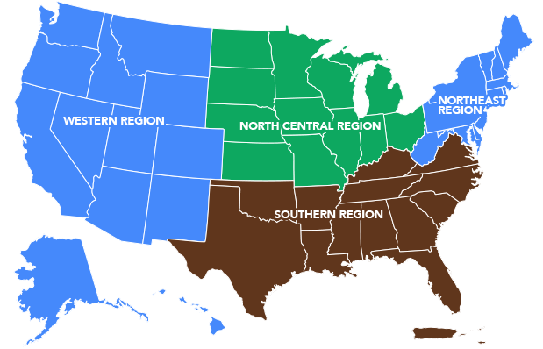





Extension Risk Management Education
Regional Centers
www.extensionrme.org

Slide 18
Looking at risk management education
http://westrme.wsu.edu/
Risk categories:
Production
Marketing
Financial
Legal
Human

Slide 19
Extension ERME Grants
Summary of ERME grant objectives
To educate producers about the full range of risk management alternatives
Our funding objective is the improved ability of farm and ranch families to manage the risks associated with farming and ranching businesses
Results based funding approach
Understand, Evaluate, Develop, Decide, Implement
Notes:
Effective risk management education should help producers make a comparative risk assessment of alternative production or management practices
Education does involve developing curriculum and decision support tools.

Slide 20
Extension ERME Grants
Introduction of new priority area:
Farm management and financial benchmarking
High degree of farm accounting integrity from FFSC
High degree of success of past projects
Applied value of FINBIN
Notes:
FFSC
Farm Financial Standards Council

Slide 21
Benchmark machinery investment

Slide 22
Benchmark HRW wheat production
Notes:
Timing? All other things equal

Slide 23
Additional emerging risk issues
ERME national conference – Indianapolis 2014
Jason Henderson – Will History Repeat Itself?
Farm Debt Outstanding at Commercial Banks
Source: FDIC, Call Report data

Slide 24
Future interest rates?
How does an exit strategy affect agriculture?
Federal Reserve System Balance Sheet: Assets
Source: Federal Reserve Bank of Cleveland

Slide 25
Financial literacy education needed
Use of debt and how lending decisions are made
Outlook on interest rates and future economic outlook and planning now for the future

Slide 26
Additional emerging risk issues
Farm transition and estate planning
A lot of programs and grant application on this topic
A lot of resources developed on this topic
Traditional topics widely covered
Asset transfer, management transfer, communication, financial capacity
What’ missing?
Retirement planning for the “inheriting” generation

Slide 27
Conclusions
Increased risk in agriculture is requiring:
More complex analysis techniques
More complex decisions tools incorporating the risk variance parameters and site specific characteristics
Great opportunities for farm/risk management education
ERME Farm Bill education partnerships
ERME Grant program
New special emphasis area for farm management and financial benchmarking
ERME National Conference

Slide 28
Discussion and Questions
Shannon Neibergs
sneibergs@wsu.edu
509 335 6360

