Slide 1
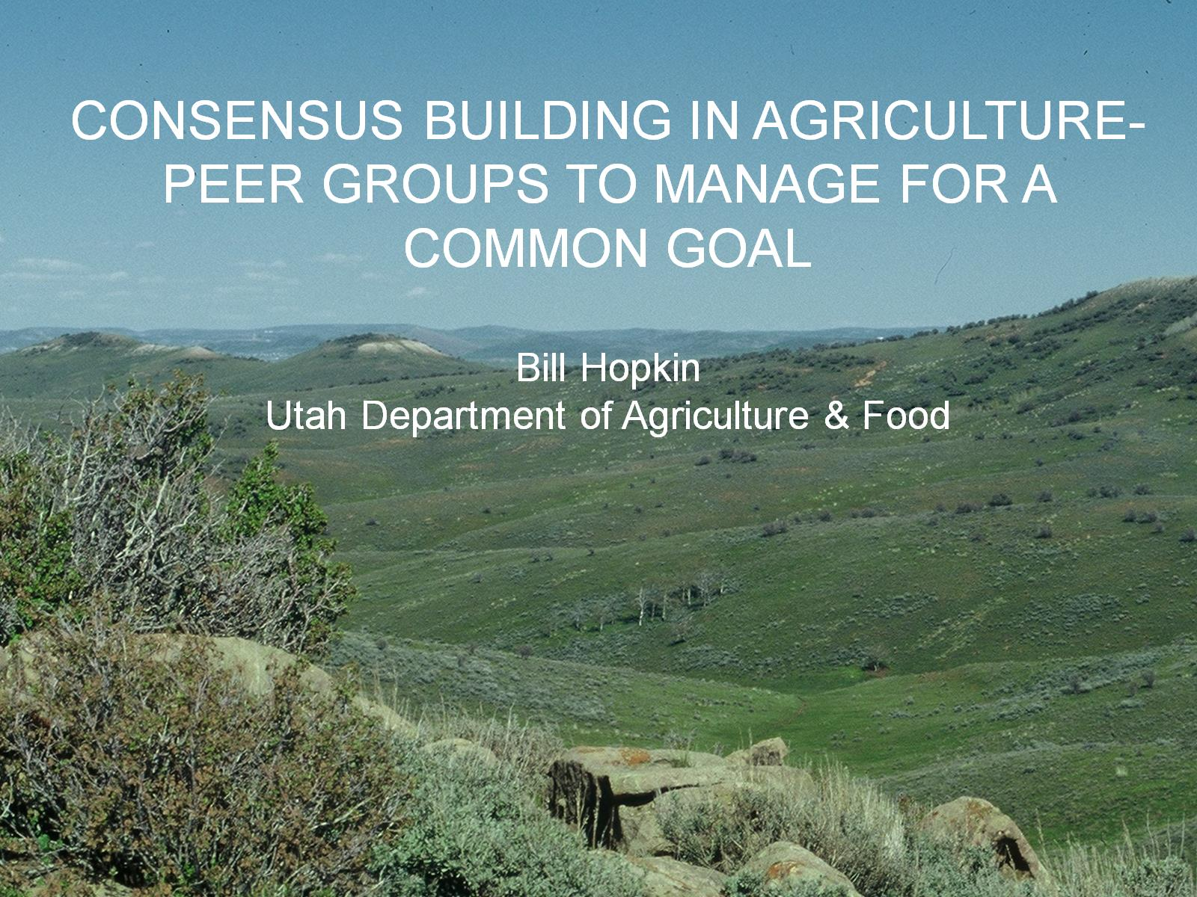
CONSENSUS BUILDING IN AGRICULTURE-PEER GROUPS TO MANAGE FOR A COMMON GOAL

Slide 2
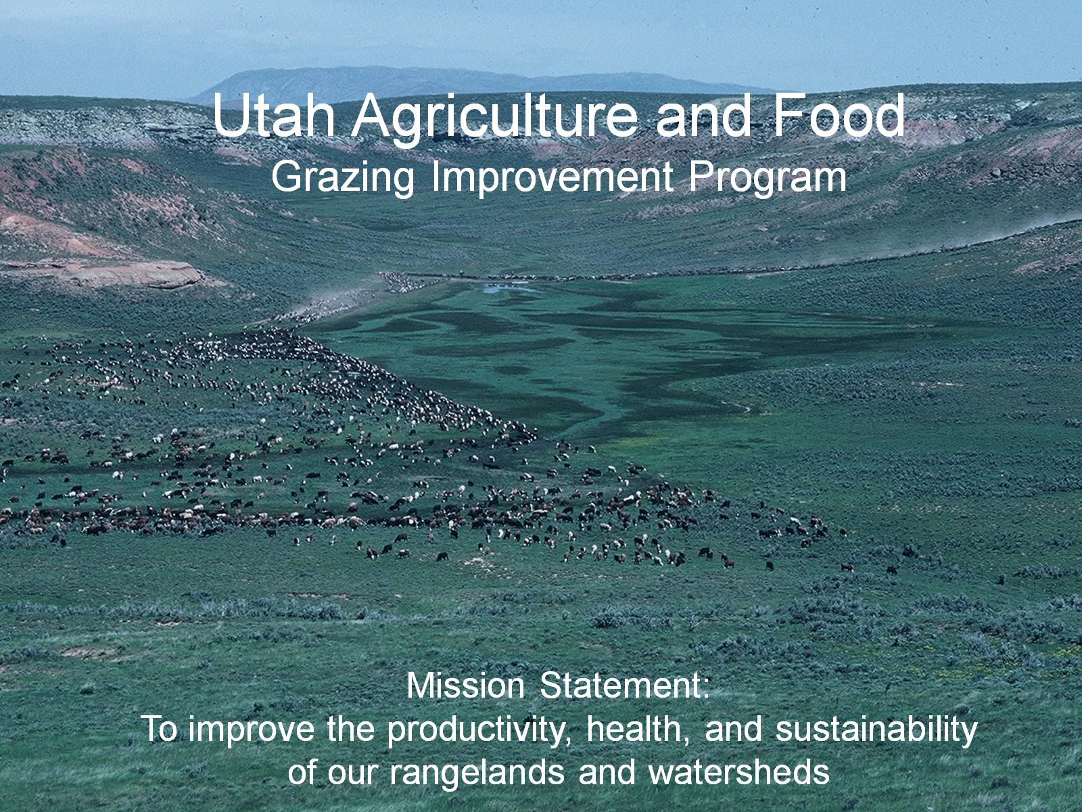
Utah Department of Agriculture and Food

Slide 3
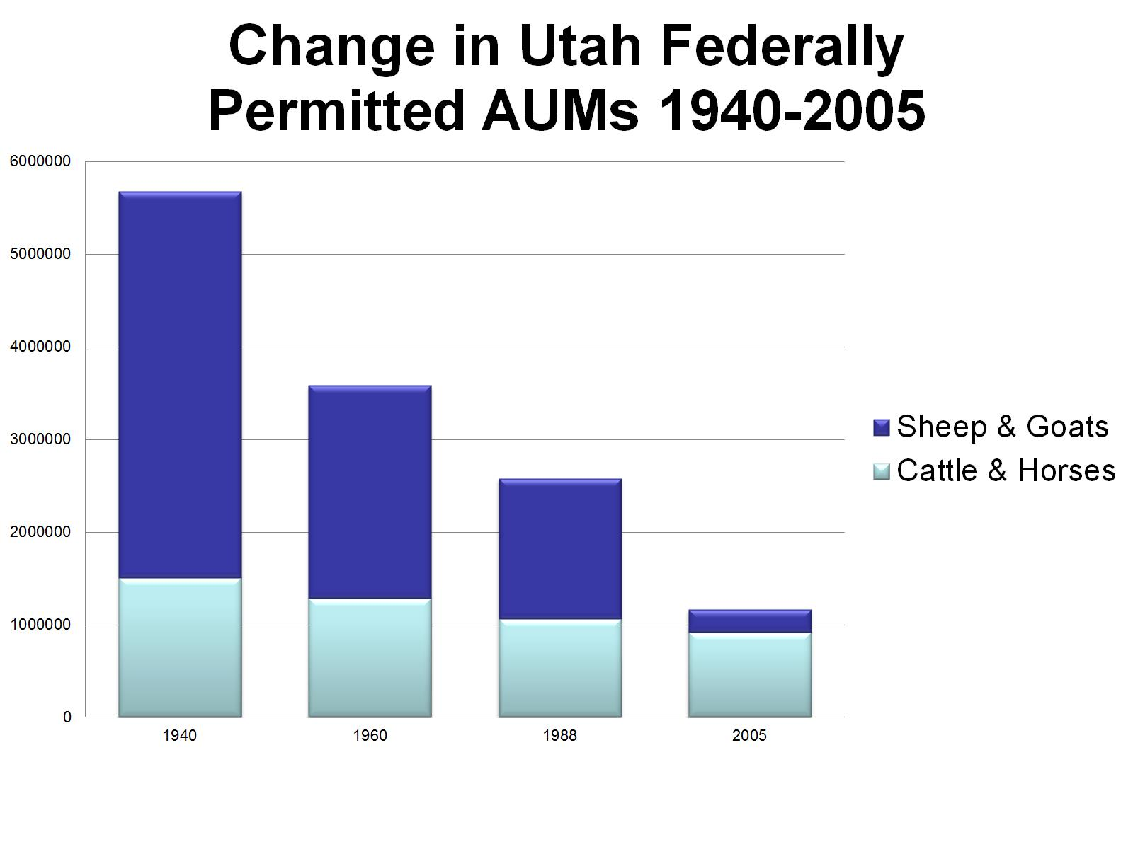

Slide 4


Slide 5
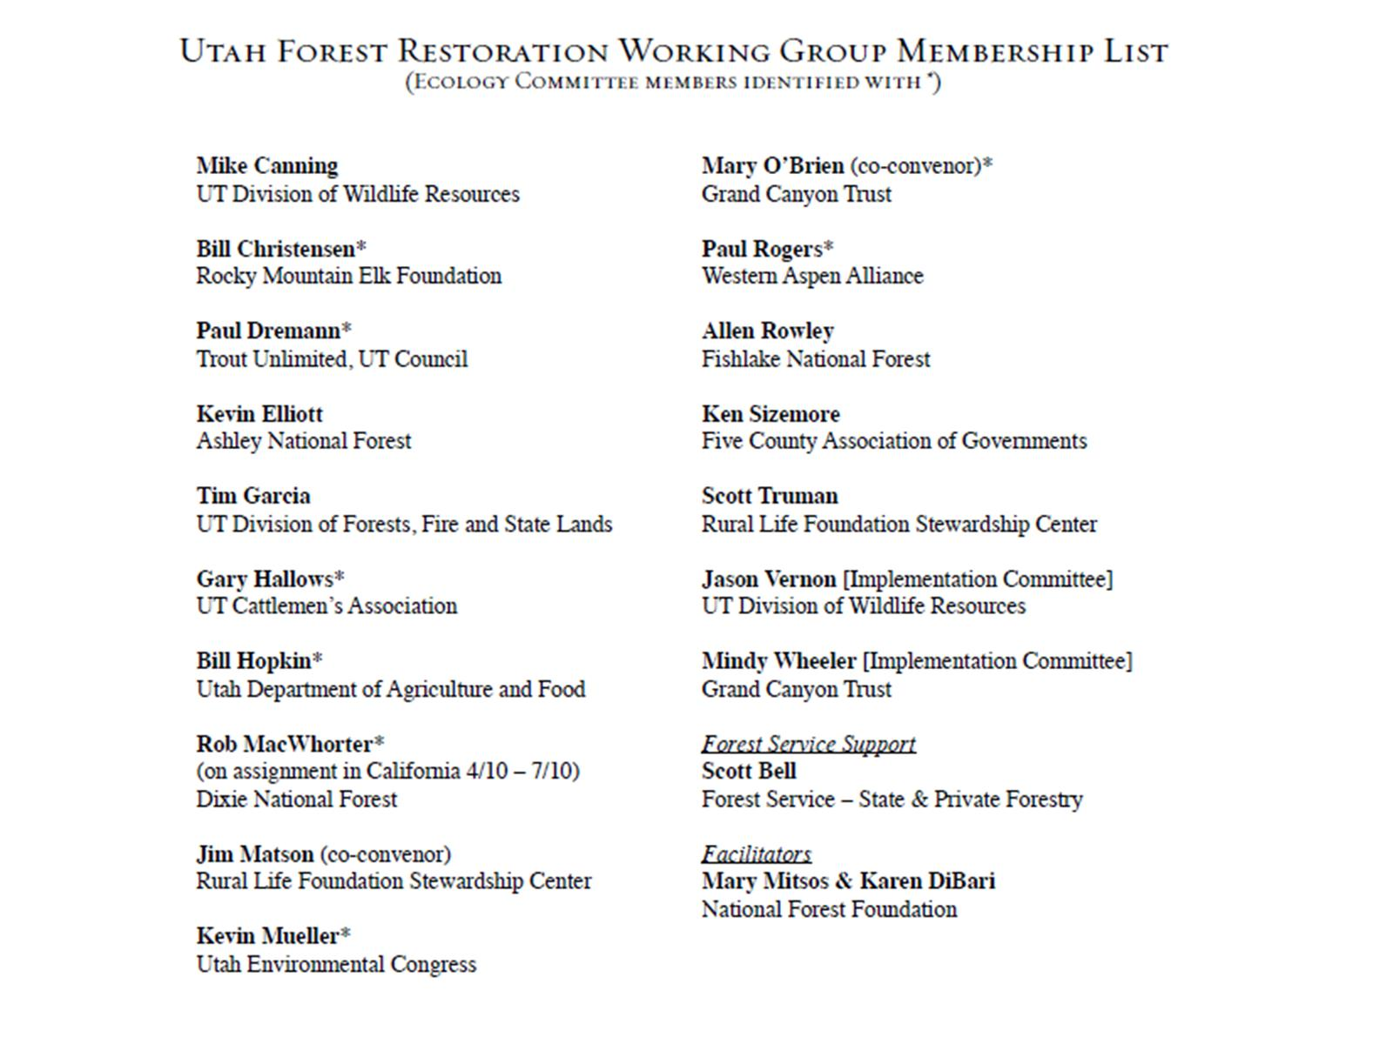

Slide 6
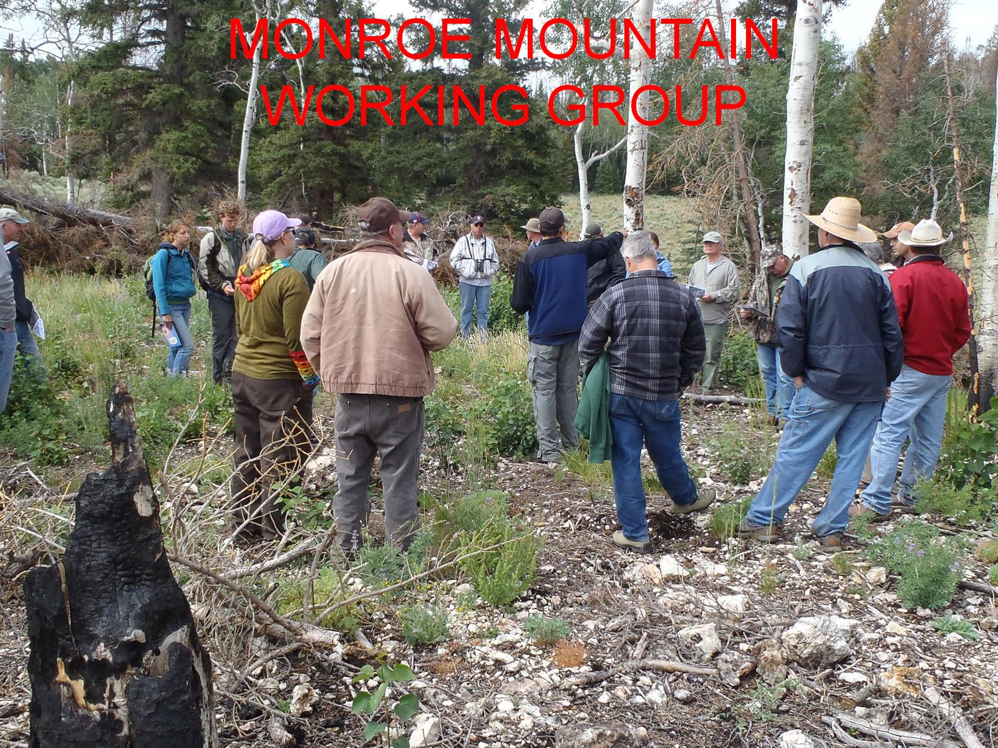
MONROE MOUNTAIN WORKING GROUP

Slide 7
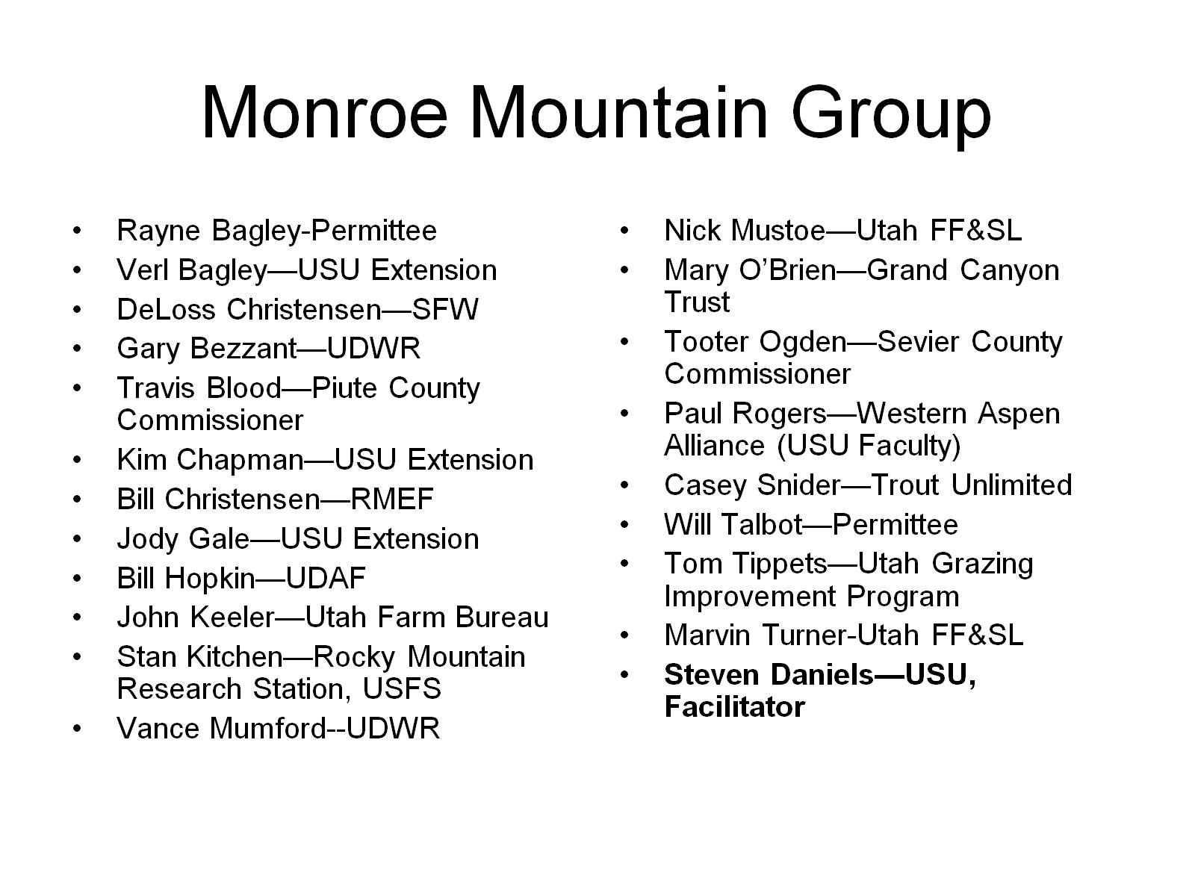
Monroe Mountain Group

Slide 8
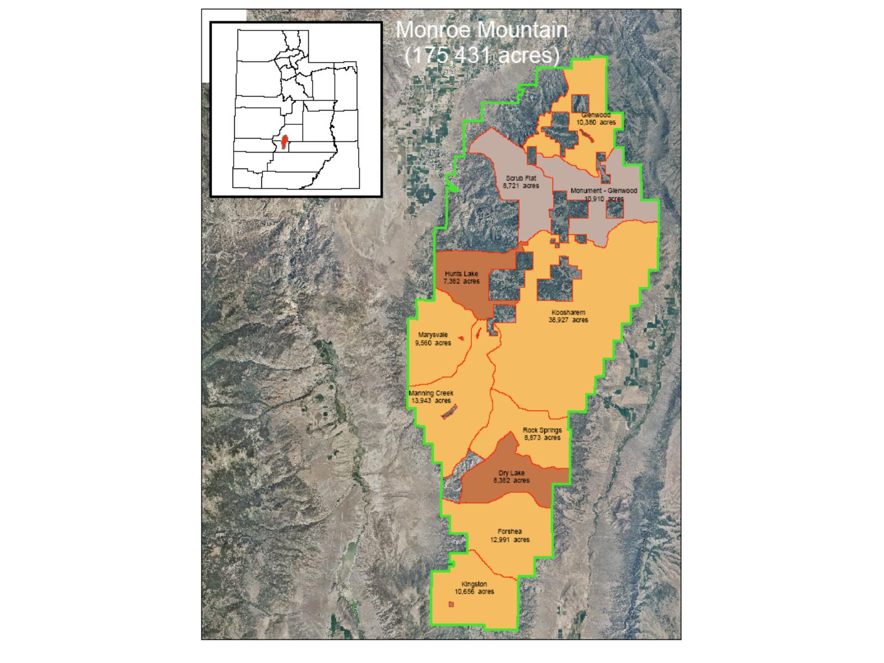

Slide 9
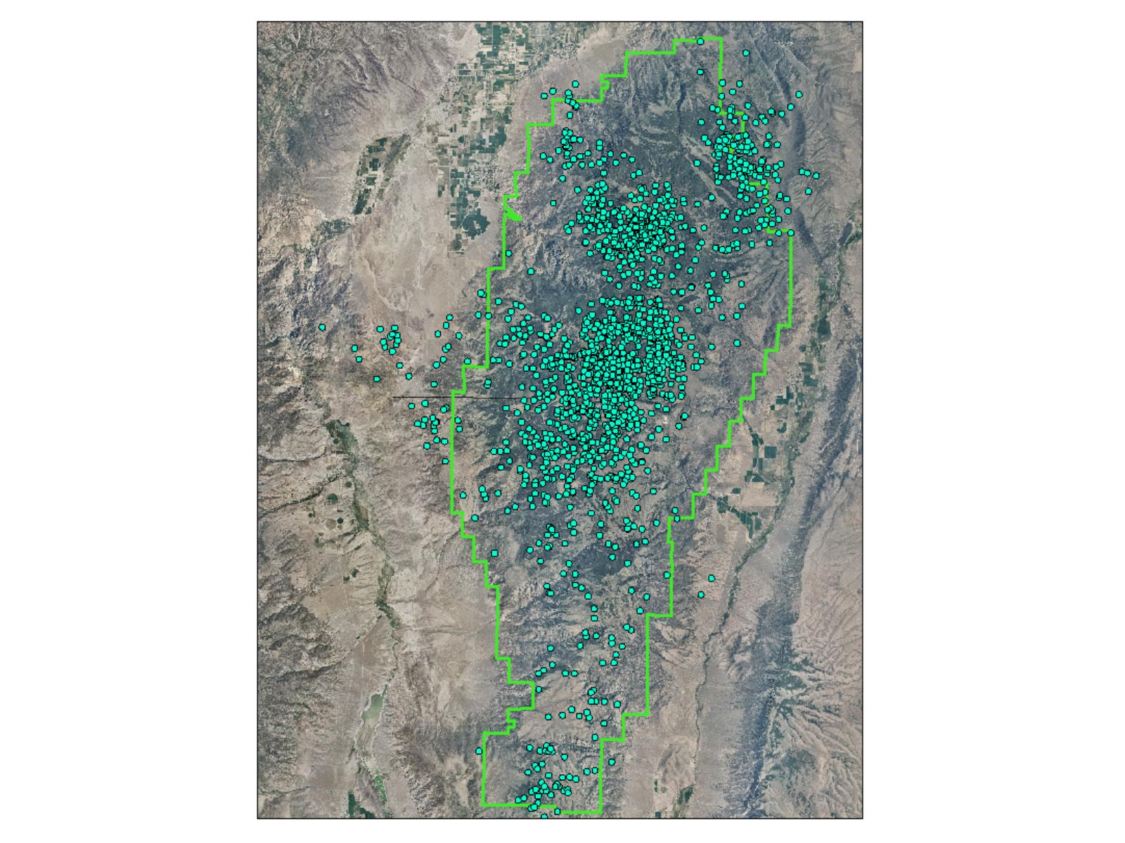

Slide 10
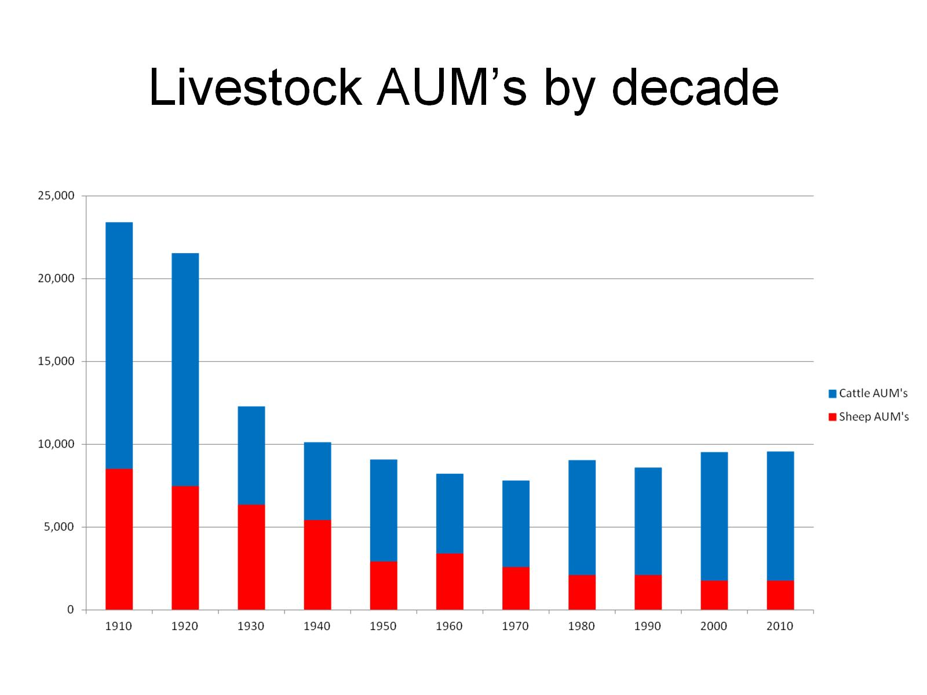
Livestock AUM’s by decade

Slide 11
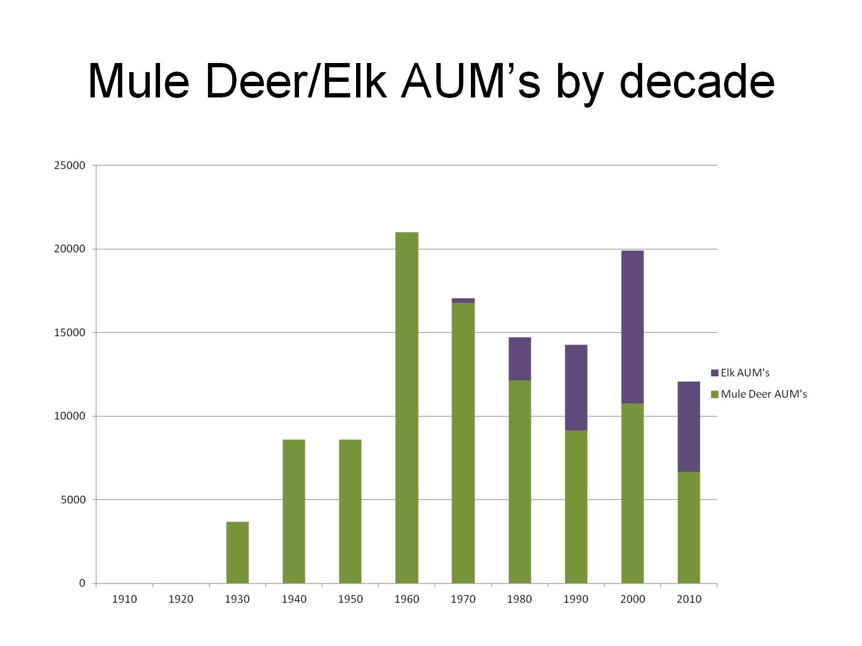
Mule Deer/Elk AUM’s by decade

Slide 12
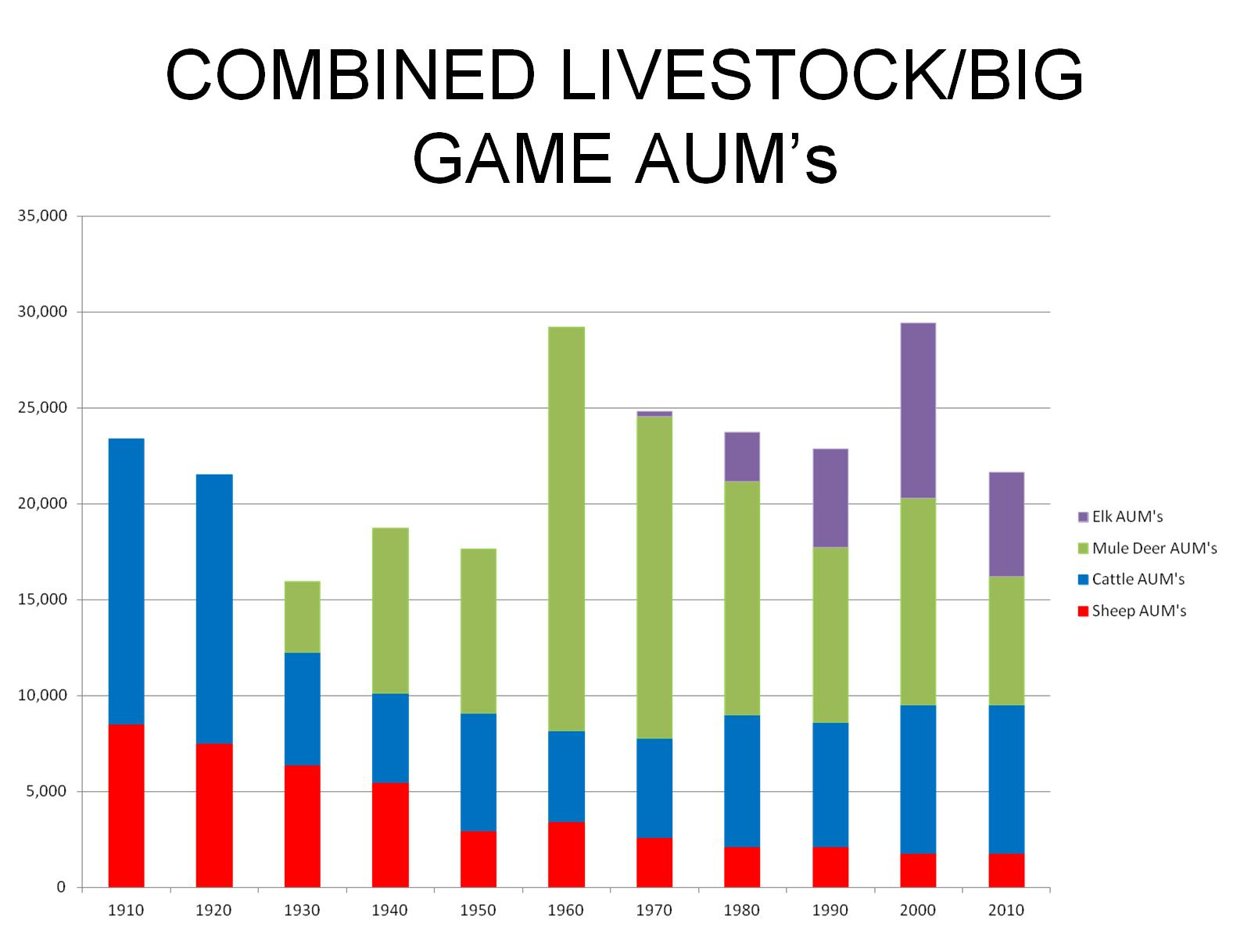
COMBINED LIVESTOCK/BIG GAME AUM’s

Slide 13
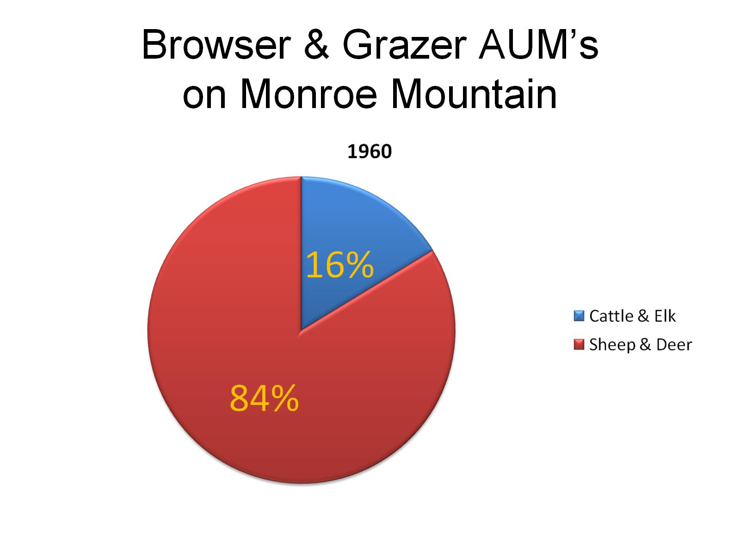
Browser & Grazer AUM’s on Monroe Mountain

Slide 14
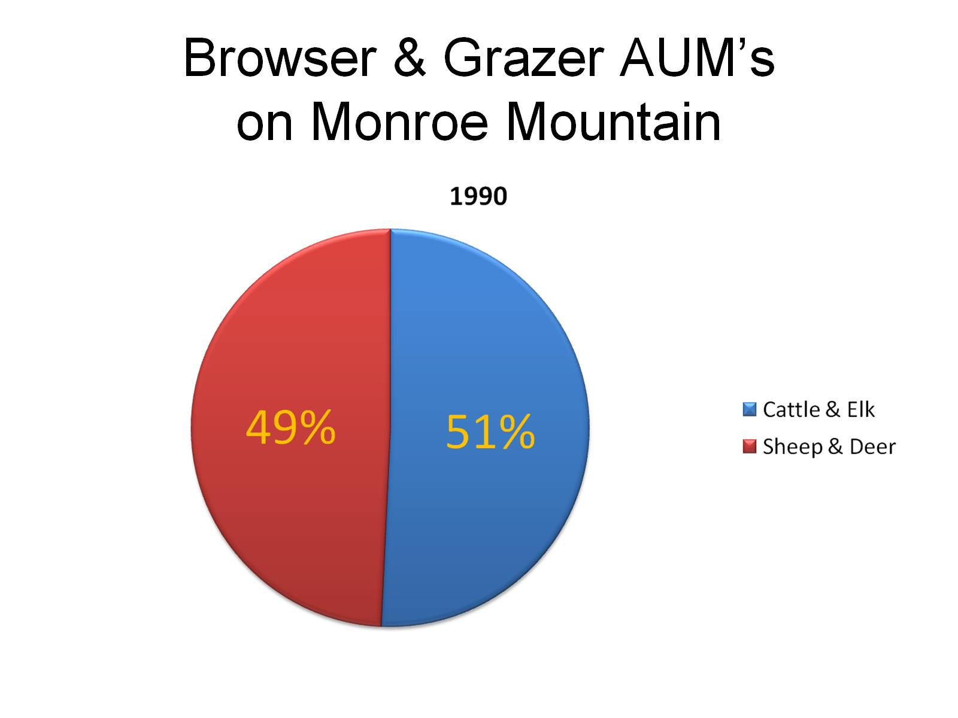
Browser & Grazer AUM’s on Monroe Mountain

Slide 15
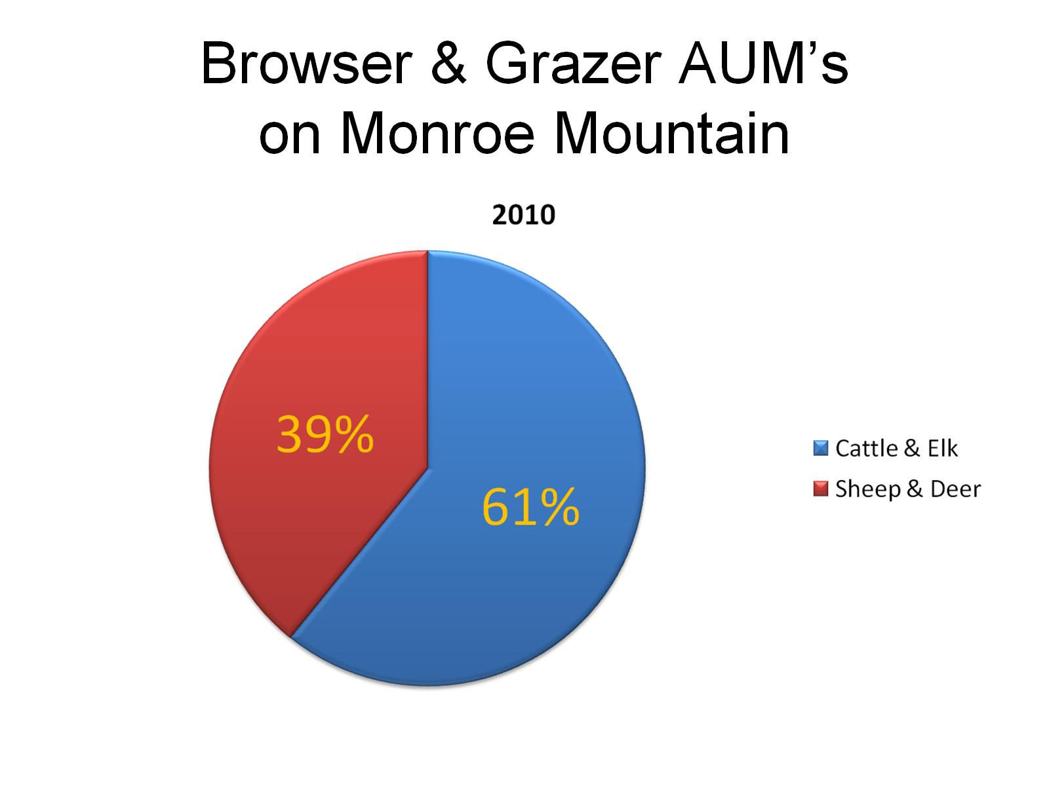
Browser & Grazer AUM’s on Monroe Mountain

Slide 16
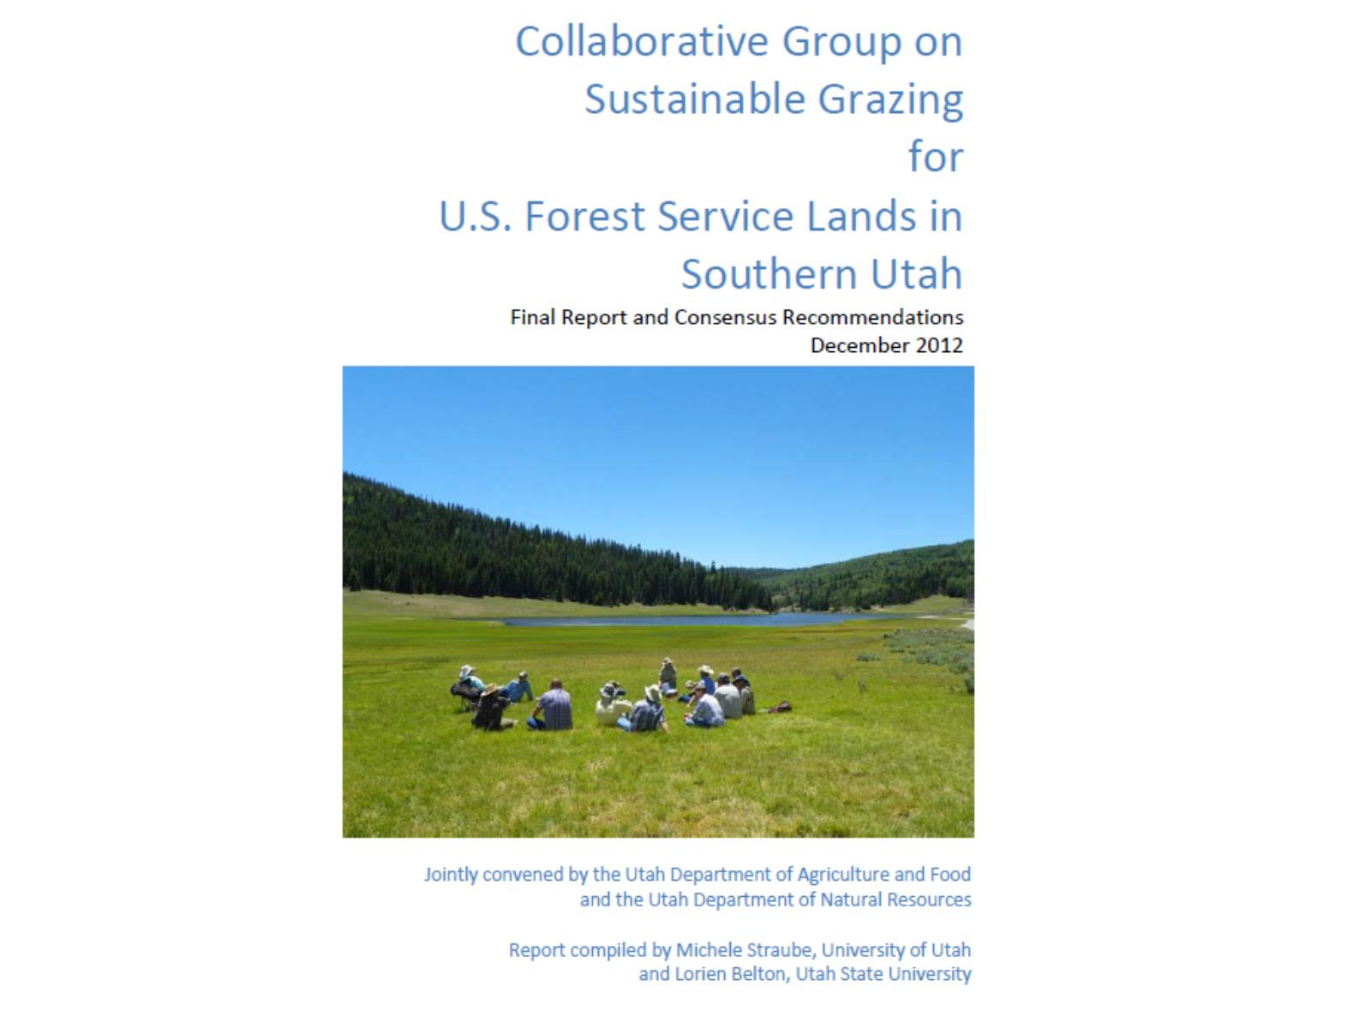

Slide 17
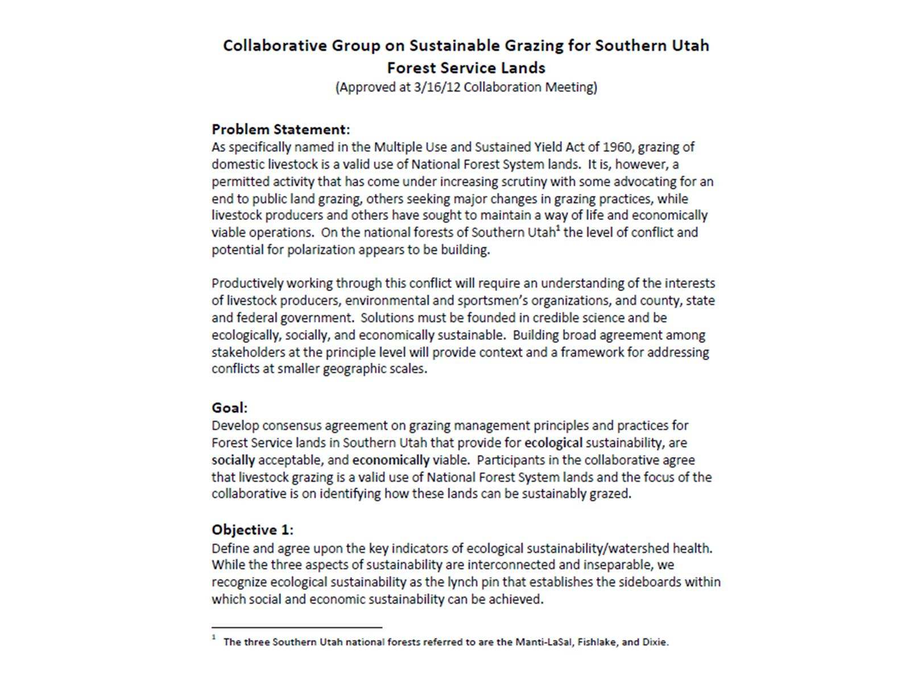

Slide 18
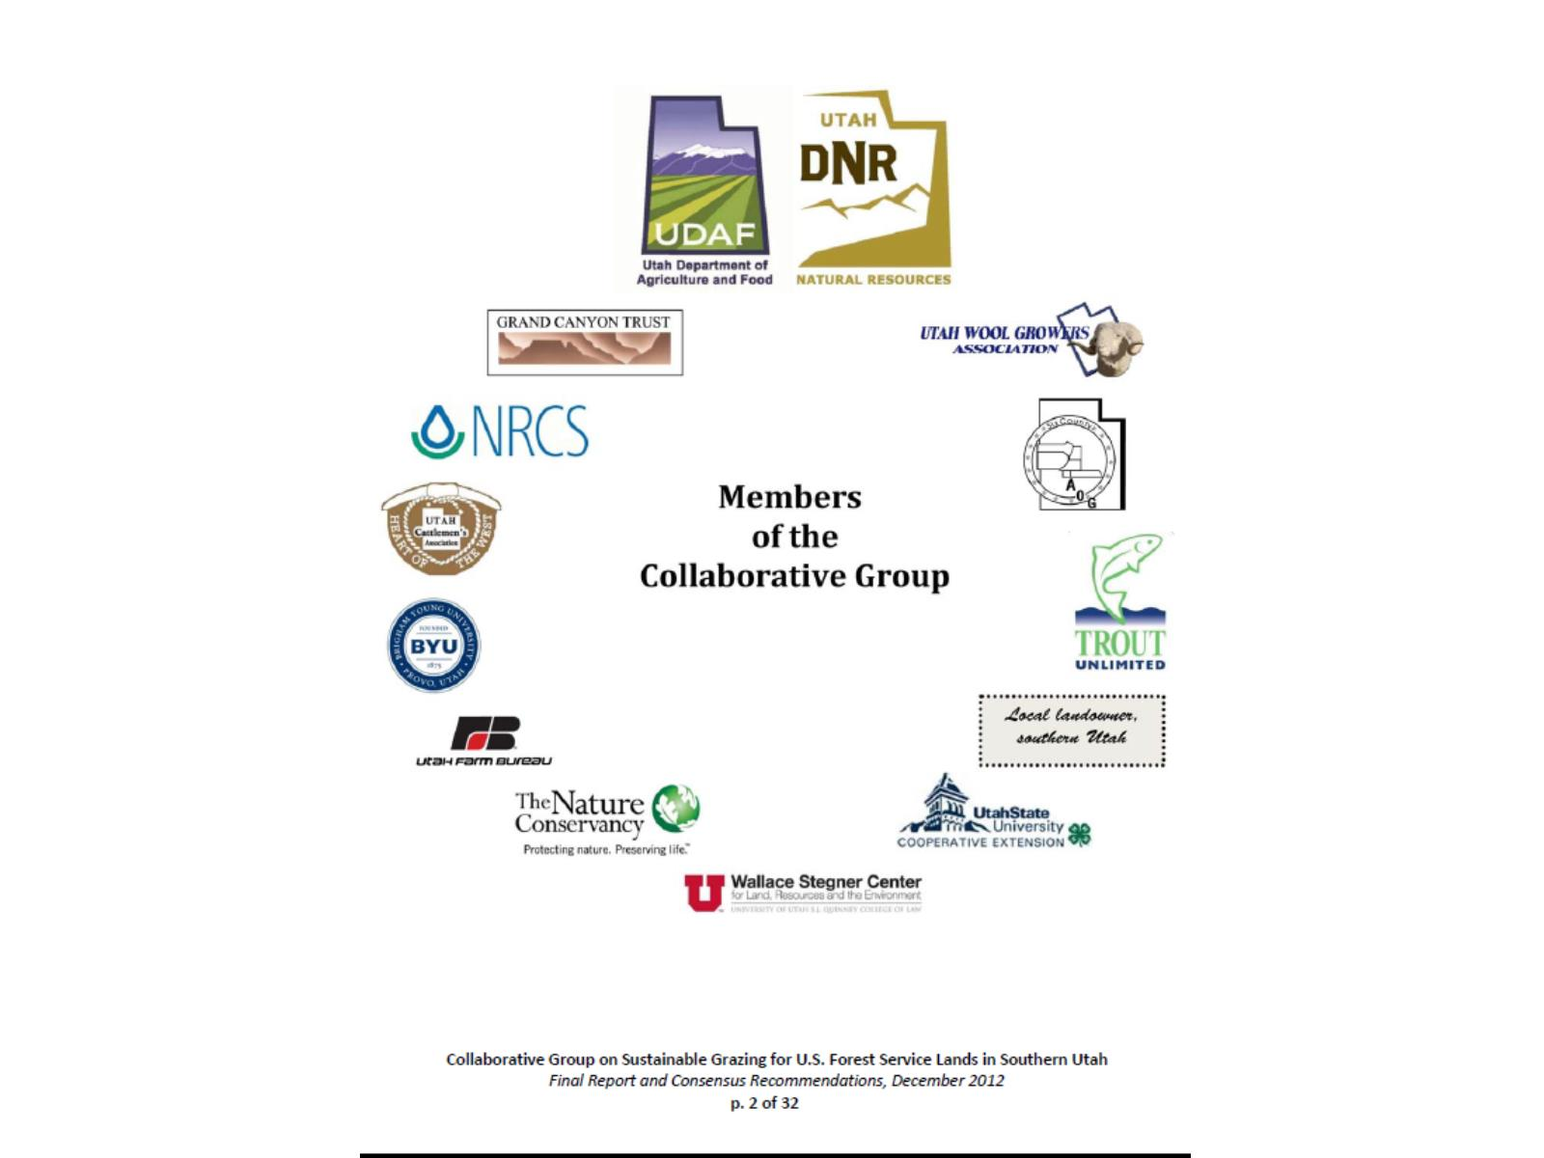

Slide 19
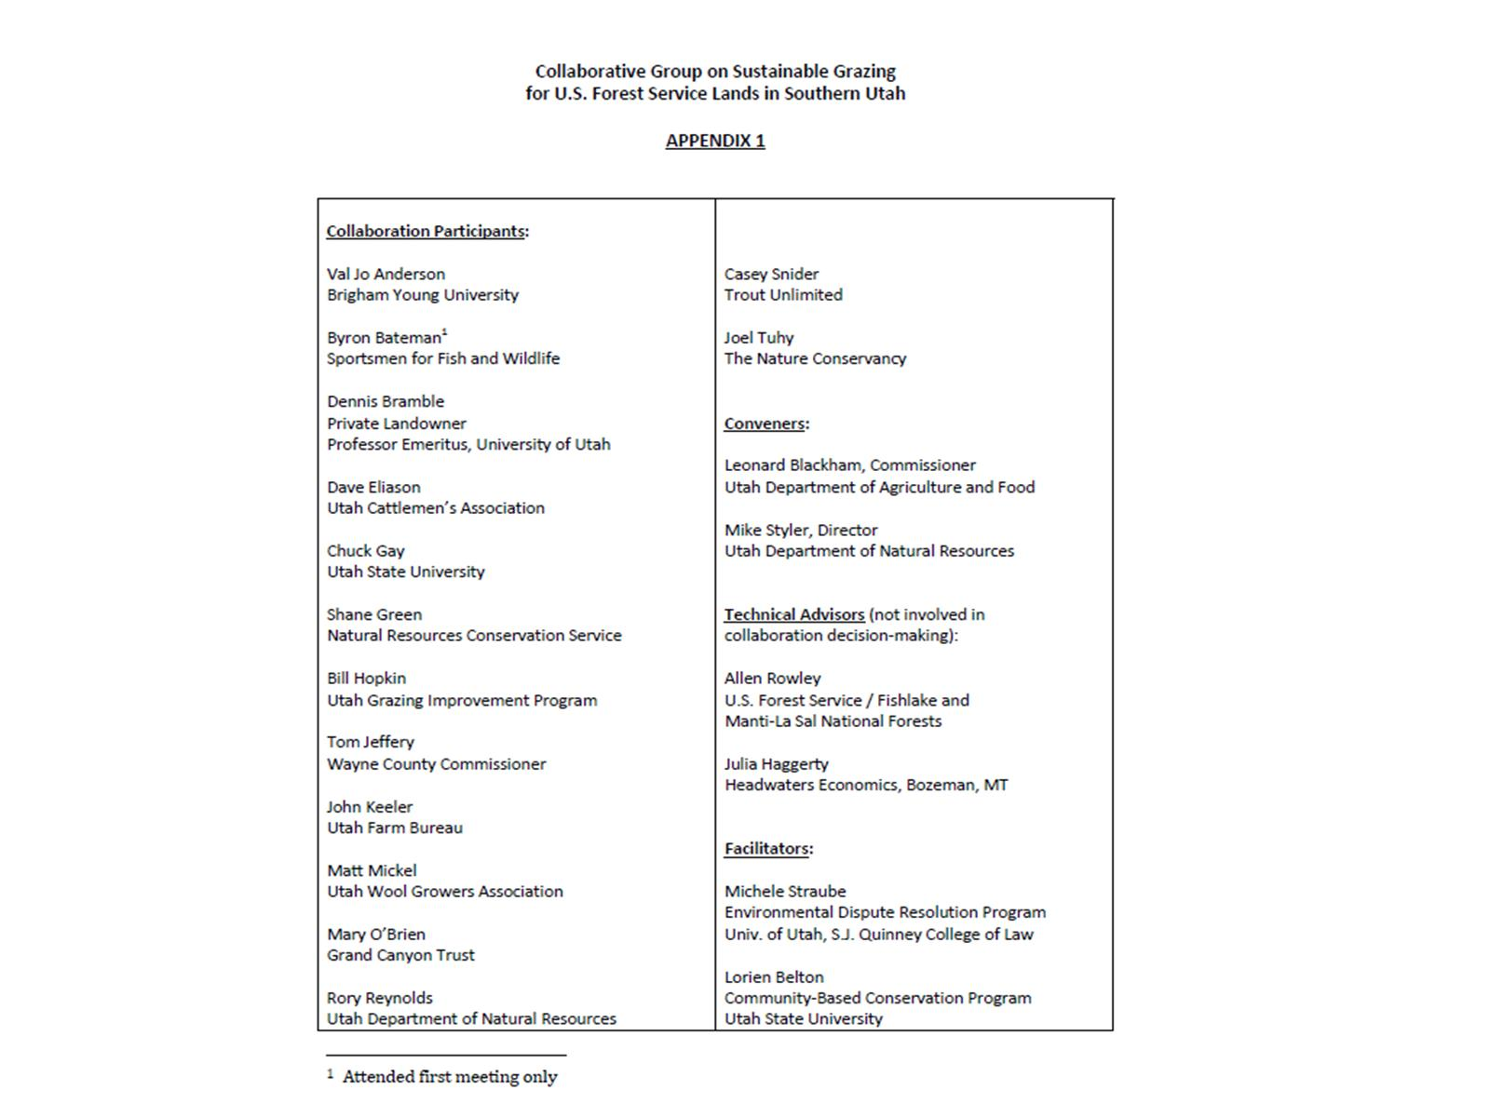

Slide 20
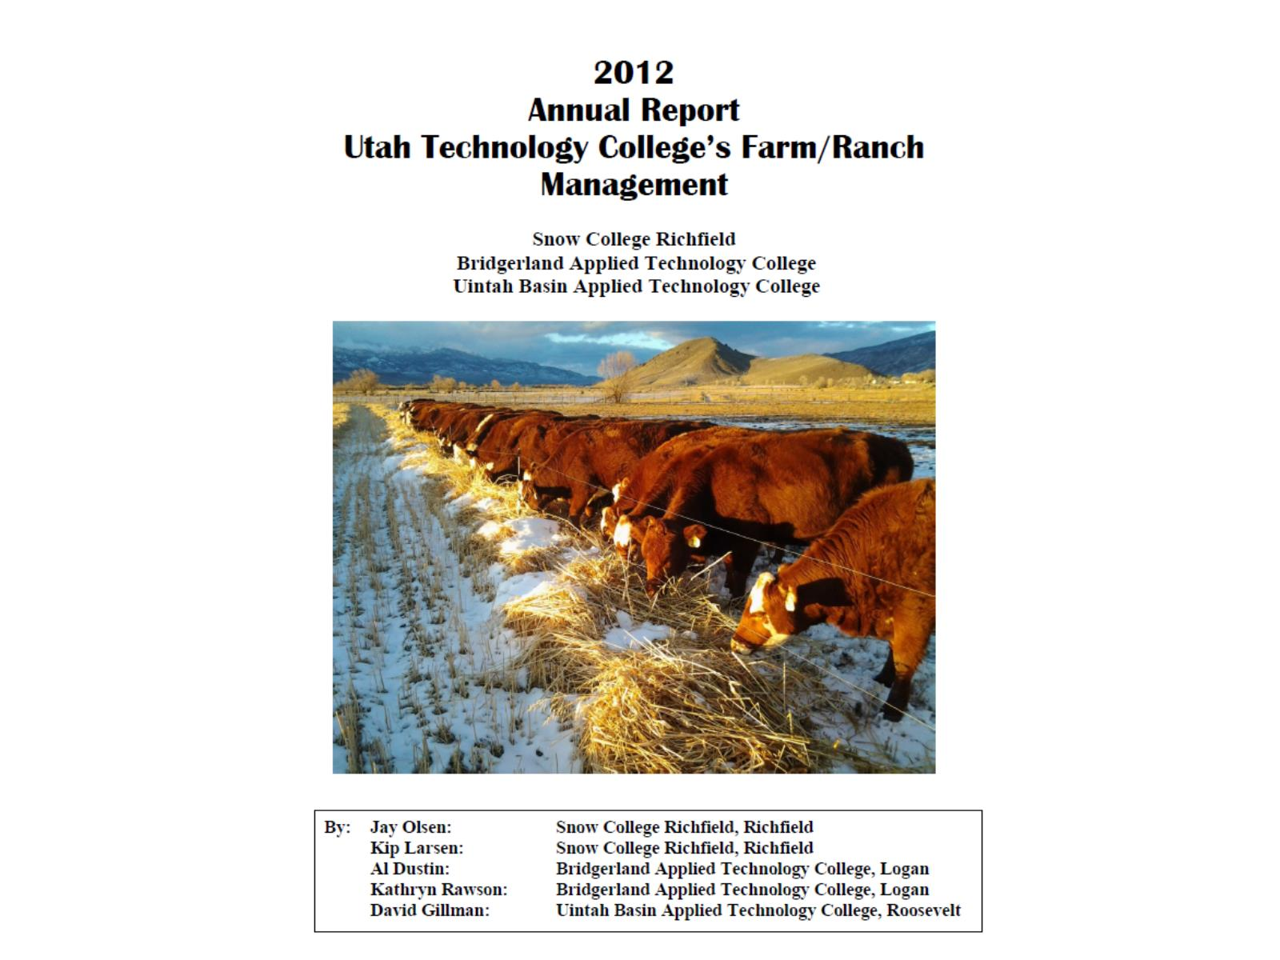

Slide 21
