Slide 1
Greenhouse Gases and Carbon Trading
Ray Massey
Commercial Ag Program
Crops Economist

Slide 2
Questions for Agriculture
Greenhouse gas limitations have the
Potential to profit agriculture
Potential to regulate agriculture
Which is the greatest potential and how will it impact agriculture?
Is agriculture a source of offsets or a source of emissions?

Slide 3
Terminology
Allowance – the quantity of emissions that the government permits an entity to release
Credit – quantity of emissions that an entity releases below its allowance. These can be save or traded.
Offset – quantity of emission destroyed, sequestered or not released that can be traded in the market.

Slide 5
US Sources of Greenhouse Gases, 2008
Source: EPA. Inventory of U.S. Greenhouse Gas Emissions and Sinks: 1990-2008

Slide 6
Agricultural Sources of Greenhouse Gases, 2008
Source: EPA. Inventory of U.S. Greenhouse Gas Emissions and Sinks: 1990-2008

Slide 7
EPA Key Categories of GHG Emissions, 2008
Source: EPA. Inventory of U.S. Greenhouse Gas Emissions and Sinks: 1990-2007

Slide 8
Agriculture’s Perspective
Agriculture Can Provide Environmental Benefits via:
Carbon Sequestration in soils and forests
Methane Capture and Destruction
Renewable Fuels
Increased Efficiency

Slide 9
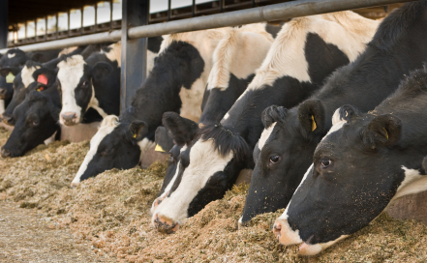
Agriculture’s Perspective
Producing one billion kg of milk in 2007 compared to 1944 requires:
79% fewer animals,
77% less feedstuffs,
65% less water, and
90% less land
The carbon footprint was reduced 63%
Source: Capper, J. L., Cady, R. A., and Bauman, D. E. (2009). The environmental impact of dairy production: 1944 compared with 2007. J. Anim. Sci. 1910.

Slide 10
World Challenge to Agriculture
To reduce GHG emissions in absolute numbers:
Reduce the quantity produced
Improve efficiency to keep below a target emission
The problem is that all estimates of demand for agricultural products are increasing.
Reducing quantity produced is not an option
Must both improve efficiency and increase production

Slide 11
The Regulatory Situation
The EPA currently has authority to regulate GHG emissions under the Clean Air Act
Already requiring emission reporting for those emitting over 25,000 tons of CO₂ equivalents.
Estimated that 107 livestock operations will need to report.
Proposed that those emitting over 100,000 tons of CO₂ equivalents after July 2011 be required to obtain a permit to do so.
Estimated that no crop and livestock operations will need a permit

Slide 12
The Situation
Unless Congress acts, the EPA will regulate GHG as it sees fit.
Current Congressional action to create a cap-and-trade system for GHG emissions
Waxman-Market bill passed the U.S. House of Representatives
Kerry-Lieberman proposal appears to be the best chance of the U.S. Senate acting
The details of any Cap-and-trade legislation, and subsequent regulations, will put agriculture in a favorable or unfavorable position.

Slide 13
Cap-and-Trade Major Players
The Government
Entities Subject To Emission Caps
Entities Able To Provide Emission Offsets
Other Interested Parties
The Market

Slide 14
Current GHG Markets
Chicago Climate Exchange (CCX) – voluntary market for greenhouse gas trading.
European Union Emissions Trading System (EU ETS) and Climate Exchange (ECX) - EU wide mandatory GHG cap-and-trade.
Regional Greenhouse Gas Initiative (RGGI) – eastern states electric power generation cap on emissions.
Others: Western Climate Initiative, Midwest Greenhouse Gas Reduction Accord, CA Scoping Plan, others

Slide 15
Government
Determines according to policy objectives:
Who is subject to a cap
Who can provide offsets
What the caps are and when they are to be reached
Market Rules
The Chicago Climate Exchange currently determines these – as a market rather than as a regulator.

Slide 16
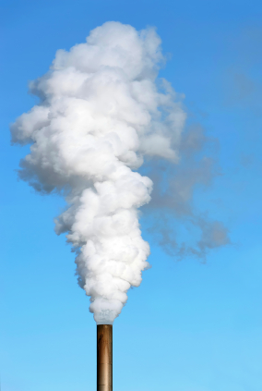
Capped Entities
Determined by government according to some type of benefit cost analysis
Point sources of emissions
Sufficient size to regulate
Capping upstream emissions is simplest but does not permit as much policy discretion.
See Stavins, Robert. 2008. Addressing Climate Change with a Comprehensive Cap-and-Trade System. Oxford Review of Economic Policy. Vol.24-2. pp. 298-322.

Slide 17
Capped Sources in the Market
 | EU ETS | RGGI | CCX
Electric Power Generation | Yes | Yes | Voluntary
Energy Intensive Manufacturing | Yes | No | Voluntary
Indirect GHG emitters (e.g. businesses with negligible GHG emissions) | No | No | Voluntary

Slide 18
Key categories are likely sources for emissions cap
Direct fertilizers
Non-point source pollution difficult to cap.
Cap the upstream source – either ammonia producer or natural gas supplier.
Enteric fermentation
Cap would be difficult to implement.
Tax would be easier to implement.
Manure Management
Most easily subject to cap.
Only farm level emission subject to EPA mandatory emissions reporting rule

Slide 19
Enteric Fermentation Emissions, 2008
Enteric fermentation
Cap would be difficult to implement.
Tax would be easier to implement.
Source: EPA. Inventory of U.S. Greenhouse Gas Emissions and Sinks: 1990-2008

Slide 20
Manure Emissions, 2008
Manure Management
Methane and nitrous oxide emissions from manure storage structure are “point source”
Only farm level emission subject to EPA mandatory emissions reporting rule
Source: EPA. Inventory of U.S. Greenhouse Gas Emissions and Sinks: 1990-2008

Slide 21
Offset Providers
Determined by government according to policy considerations
Power generation without GHG emissions
Methane Destruction – emitters too small to regulate who voluntarily reduce GHG emissions in order to participate in the market
Carbon sequestration
International projects to help developing countries reduce emissions

Slide 22
Offset Providers Allowed in the Market
 | EU ETS | RGGI | CCX
Landfills | No | Yes | Yes
Manure Storage | No | Yes | Yes
Developing country projects | Yes | No | No
Soil Sequestration | No | No | Yes
Waxman-Markey American Clean Energy and Security Act of 2009
(Sec 732 (e)) “An offset credit does not constitute a property right.”

Slide 23
Offset Requirements
Permanent
Additional
Verifiable
Enforceable

Slide 24
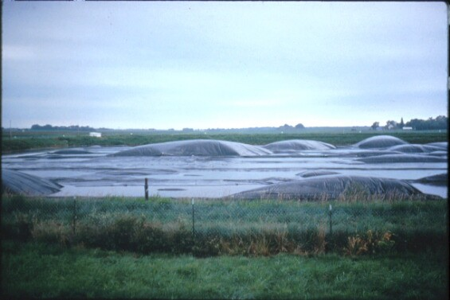
Offset Permanence: From Livestock
Methane destroyed from manure pits is a permanent reduction.
Question becomes: should livestock manure be a capped entity that must reduce its emissions before selling offsets.
Large entities (greater than 25,000 tons of CO2e) are likely to be capped.
Small entities may be uncapped and therefore sell all reductions.

Slide 25
Offset Permanence: From Crops
Problem 1: Current CCX contract lengths
Soil carbons sequestration: 5 years
Forestry: 15 years
Possible solution: increase contract lengths.
Soil carbon saturation estimated to occur within 10-50 years.
Forest carbon equilibrium depends on tree species and other factors.

Slide 26
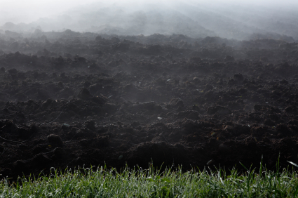
Offset Permanence: From Crops
Problem 2: After the contract expires, the sequestered carbon can be released.
Possible Solution: modify property rights to prohibit future releases.
McCarl and Schneider have a good set of policy questions about future property rights.
Notes:
McCarl and Schneider have a good set of policy questions about future property rights.

Slide 27
Offset Additionality
Only trade offsets that are done in order to obtain the carbon reductions
CCX carbon sequestrations that are not additional
CRP after 1999 but before the contract
No-till from farmers that were already no-tilling
Early action credits are controversial in GHG trading schemes.

Slide 28
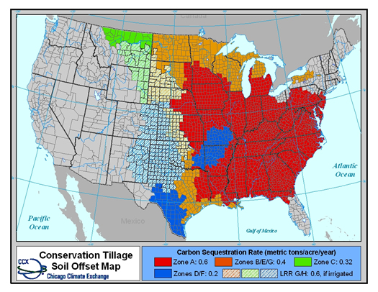
Offset Verification
CCX verification is via compliance with input requirements – not output measurements.
This is an accepted contractual system – e.g. organic produce
Audits of offset providers can insure compliance.

Slide 29
Other Interested Parties
Aggregators – assist small entities enter the market
Liquidity providers – banks and financial institutions
Environmentalists – purchase offsets and lobby for policy changes
Green industries that benefit from regulations and lobby for policy changes

Slide 30
The Market
Determined by government according to policy considerations
Permitted trading region:
Regional?
National?
International?
Initial allocation of allowances greatly affects market performance

Slide 31
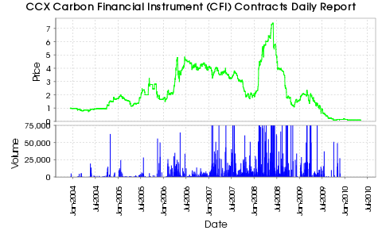
Voluntary Market for CO₂ in US
http://www.chicagoclimatex.com/market/data/summary.jsf 5/12/10

Slide 32
Mandatory Market for CO₂ in European Union
$45
$30
$15
http://www.europeanclimateexchange.com/ 11/13/09
Notes:
http://www.ecx.eu/EUA-Futures click on Prices, Volume and Open interest: ECX EUA Futures Contract to download. This was in the 2009 tab (not the Detail 2009 tab).

Slide 33
Green House Gases and Carbon Trading
Ray Massey
Commercial Ag Program
Crops Economist

Slide 34
CO₂ Sources, 2007
Note: not all GHG shown in this chart.
Source: EPA. Inventory of U.S. Greenhouse Gas Emissions and Sinks: 1990-2007

Slide 35
U.S. CO₂ Credit Estimates
Administration: $13-14 per ton CO₂
Congressional Budget Office: $23 to 44 per ton CO₂
Energy Information Administration: $40.75 to 123.66 per ton CO₂
Wall Street Journal March 9, 2009

Slide 36
Texas A&M Analysis of H.R. 2454
Used mostly EPA analysis of prices for their estimate of impact on agriculture.
Item | Inflation change ( average and illustrative)
Motor Fuel | 4%
Natural Gas | 8.5%
Electricity | 12.7%
Nitrogen Fertilizer | -3%
Carbon Credits | $9 to $13 per ton

Slide 37
Texas A&M Analysis of H.R. 2454
Cash receipts
Prices due to shifts in acreage or production
Selling carbon credits
Cash outlays
Higher energy costs for fuel and electricity
Higher chemical prices resulting from higher energy costs
Lower Nitrogen fertilizer costs due to EITE allowances
Notes:
EITE – energy intensive, trade-exposed

Slide 38
Texas A&M Analysis of H.R. 2454
Key: Green = higher ending cash
Red = lower ending cash
Source: Texas A&M Ag and Food Policy Center, Research Paper 09-2
Notes:
Economic Implications of the EPA Analysis of the CAP and Trade
Provisions of H.R. 2454 for U.S. Representative Farms

Slide 39
Copenhagen Consensus
Question: how to spend $50 billion to address most important world problems.
May 2004
38 economists
8 prepared a paper on serious global problems
20 engaged in open debate
8 (4 Nobel laureates) listened, assessed and prioritized how to spend $50 billion to address the problems.
Notes:
As usual economists are poor at math. 38 economists but only 36 accounted for.
Source: How to Spend 50 billion to make the world a better place. Page xii-xiii.

Slide 40
Copenhagen Consensus Proposal Rankings
Rank | Challenge | Opportunity
1 | Communicable Diseases | Control of HIV/AIDS
2 | Malnutrition and hunger | Providing Micronutrients
3 | Subsidies and Trade Barriers | Trade Liberalization
4 | Communicable Diseases | Control of Malaria
5 | Malnutrition and Hunger | Development of new agricultural technologies

Slide 41
Copenhagen Consensus Proposal Rankings (continued)
Rank | Challenge | Opportunity
6-8 | Sanitation and Water | Multiple
9 | Governance and Corruption | Lowering the cost of starting a new business
10, 14 | Migration | Multiple
11, 13 | Malnutrition and Hunger | Multiple
12 | Communicable Diseases | Scaled up basic health services
15 | Climate Change | Optimal carbon tax
16 | Climate Change | The Kyoto Protocol
17 | Climate Change | Value-at-risk carbon tax

Slide 42
Environmental Concerns
http://www.gallup.com/poll/117079/Water-Pollution-Americans-Top-Green-Concern.aspx
Notes:
Gallup Environmental survey on March 5-8, 2009. “I’m going to read you a list of environmental problems. As I read each one, please tell me if you personally worry about this problem a great deal, a fair amount, only a little or not at all. First, how much do you worry about ….?”

Slide 43
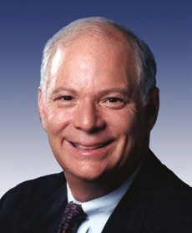
Greenhouse Gas Quotes
“…the most significant revenue-generating proposal of our time,”
Senator Benjamin Cardin (D-Md) speaking about cap-and-trade of GHG
Quoted in the Washington Post, April 3, 2009
http://www.washingtonpost.com/wp-dyn/content/article/2009/04/02/AR2009040203473.html?hpid=topnews

